Slide 1


ReConnect China Report
Phase i. – Web of Science Co-publication analysis

Slide 2





Scope
Keywords related to AI, Machine Learning & Big Data
Web of Science: Europe & China co-publications
(EU28+NOR+UK+CHE)
Qualitative analysis of the 2011-2022 period

Slide 3
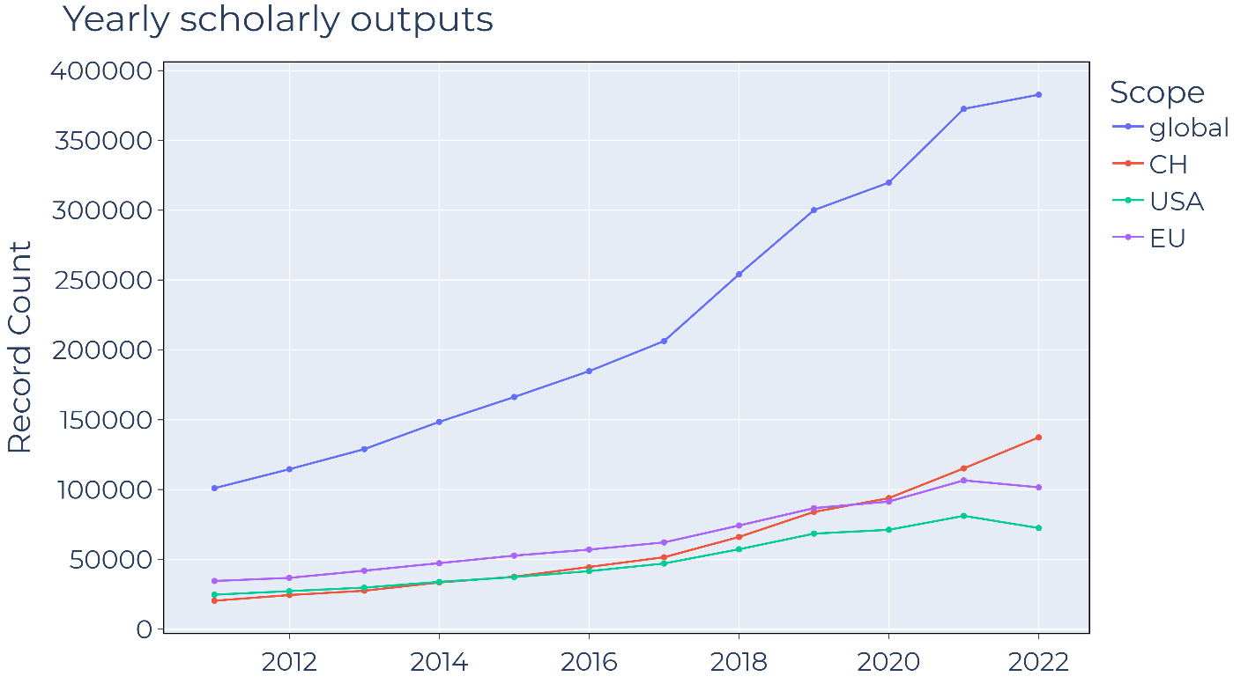
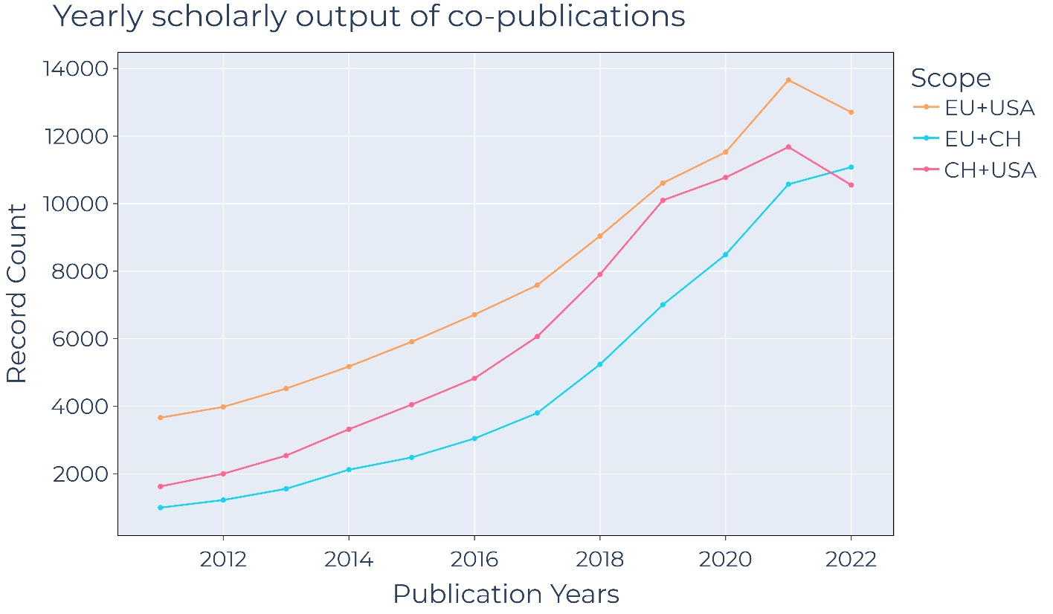
GLOBAL TRENDS IN AI & ML TOPICS
Global: Constant increase in scholarly output with a loss of momentum
Western research: similar tendencies
China: constant increase in output (probably undersampled?)
Changing collaborative patterns
Source: Web of Science

Slide 4

Methods
Identification & QA/QC of potential keywords and syntax (248) → refined tokens (210)
Classification of publications via journal METRIX taxonomy (based on ISSN)
Leveraging WOS „topic search” methodology: Title, Abstract, Keywords, Author Keywords
Documented and automatized query composition
Author address fields → Country, Institution (harmonized)

Slide 5
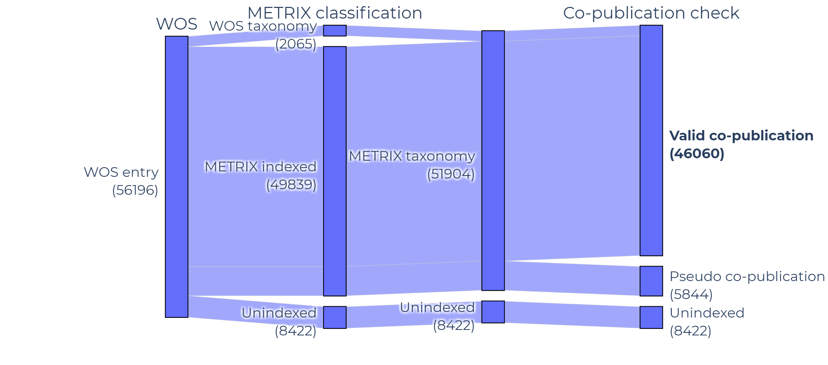
Additional methods & Data Processing Results
Query → 56196 individual entries from WOS
Number of METRIX indexed & non-duplicate records: 49839
Ad-hoc re-merge of unindexed entries using WOS taxonomy - METRIX taxonomy correspondences: +2065
After excluding „pseudo co-publications”: 46060

Slide 6
Overall Distribution & Trends

Slide 7
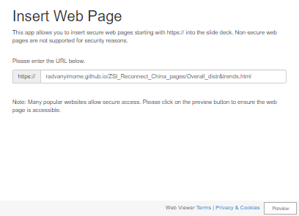
Overall Distribution & Trends (DYNAMIC)
Constant increase in scholarly output
Resembles chinese publication trends (contrary to western publication patterns in the field)
Topic of scope dominated by applicational aspects

Slide 8
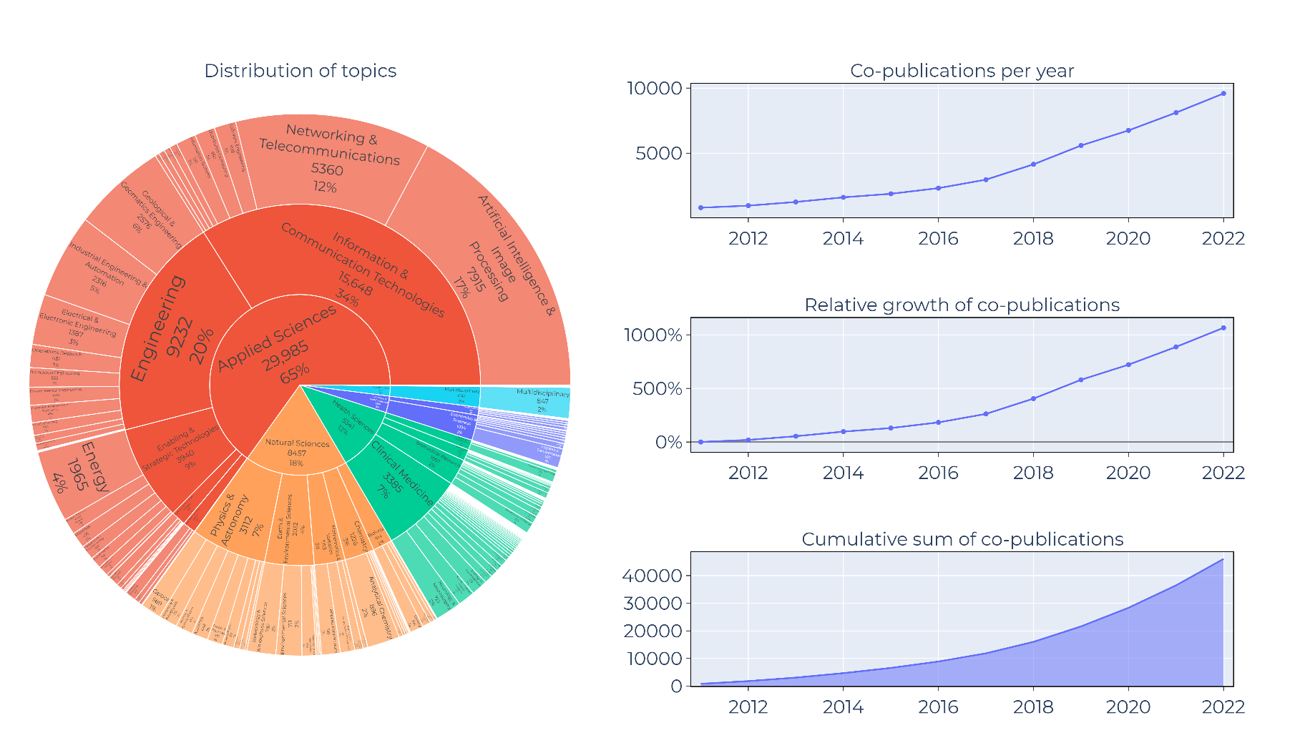
Overall Distribution & Trends (STATIC)
Constant increase in scholarly output
Resembles chinese publication trends (contrary to western publication patterns in the field)
Topic of scope dominated by applicational aspects

Slide 9
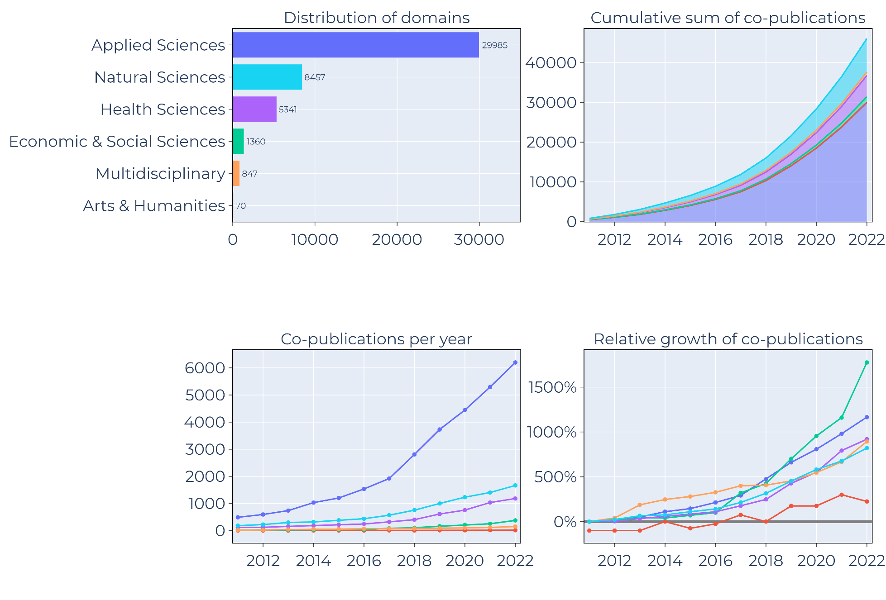
Distribution & Trends: Scientific Domains
Domination of applicational aspects
Recent relative increase of collaboration within economic domains
Remarks on multidisciplinary domain

Slide 10
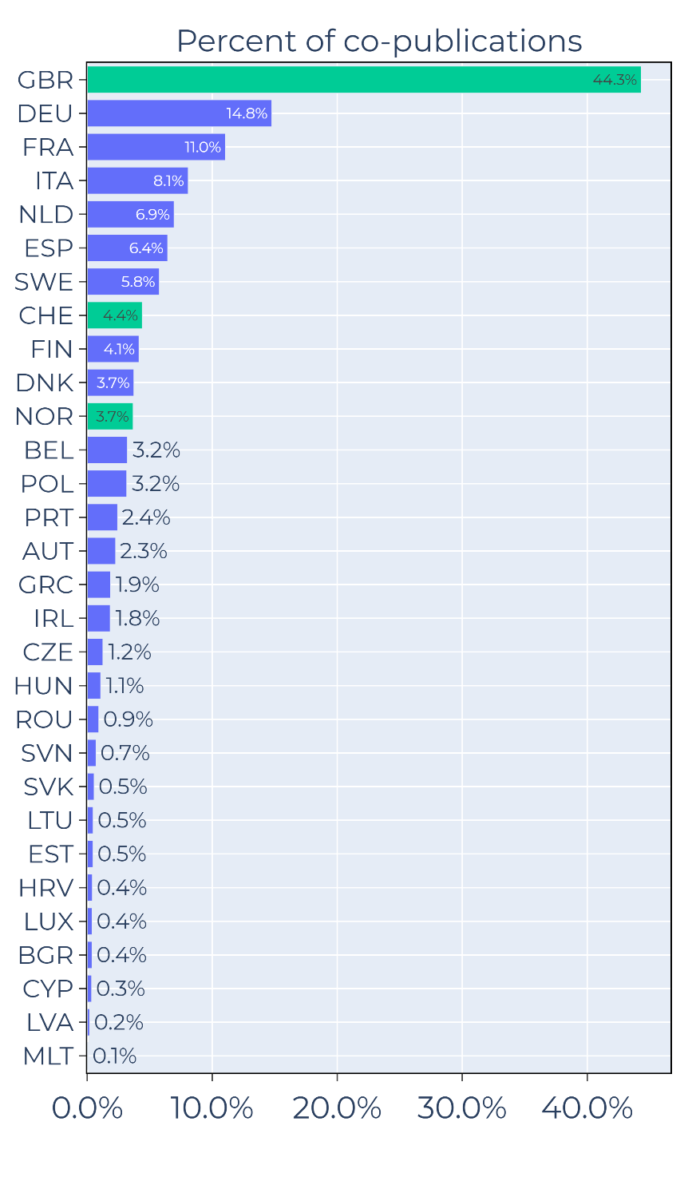
Distribution & Trends: Scientific Domains
Majority of co-publications related to Britain
Nordic countries: Norway is the smallest contributor
Baltic & Eastern region: ~6.4% of co-publications

Slide 11
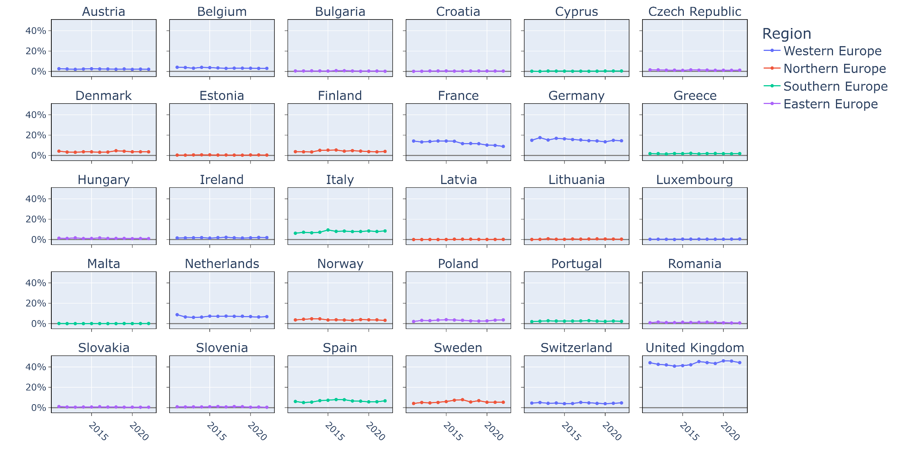
Yearly TRENDS in CO-publication FOCUS OF CHINA
Mostly constant
France: slight decline
UK: small fluctuations
Few 2015-2018 plateous

Slide 12
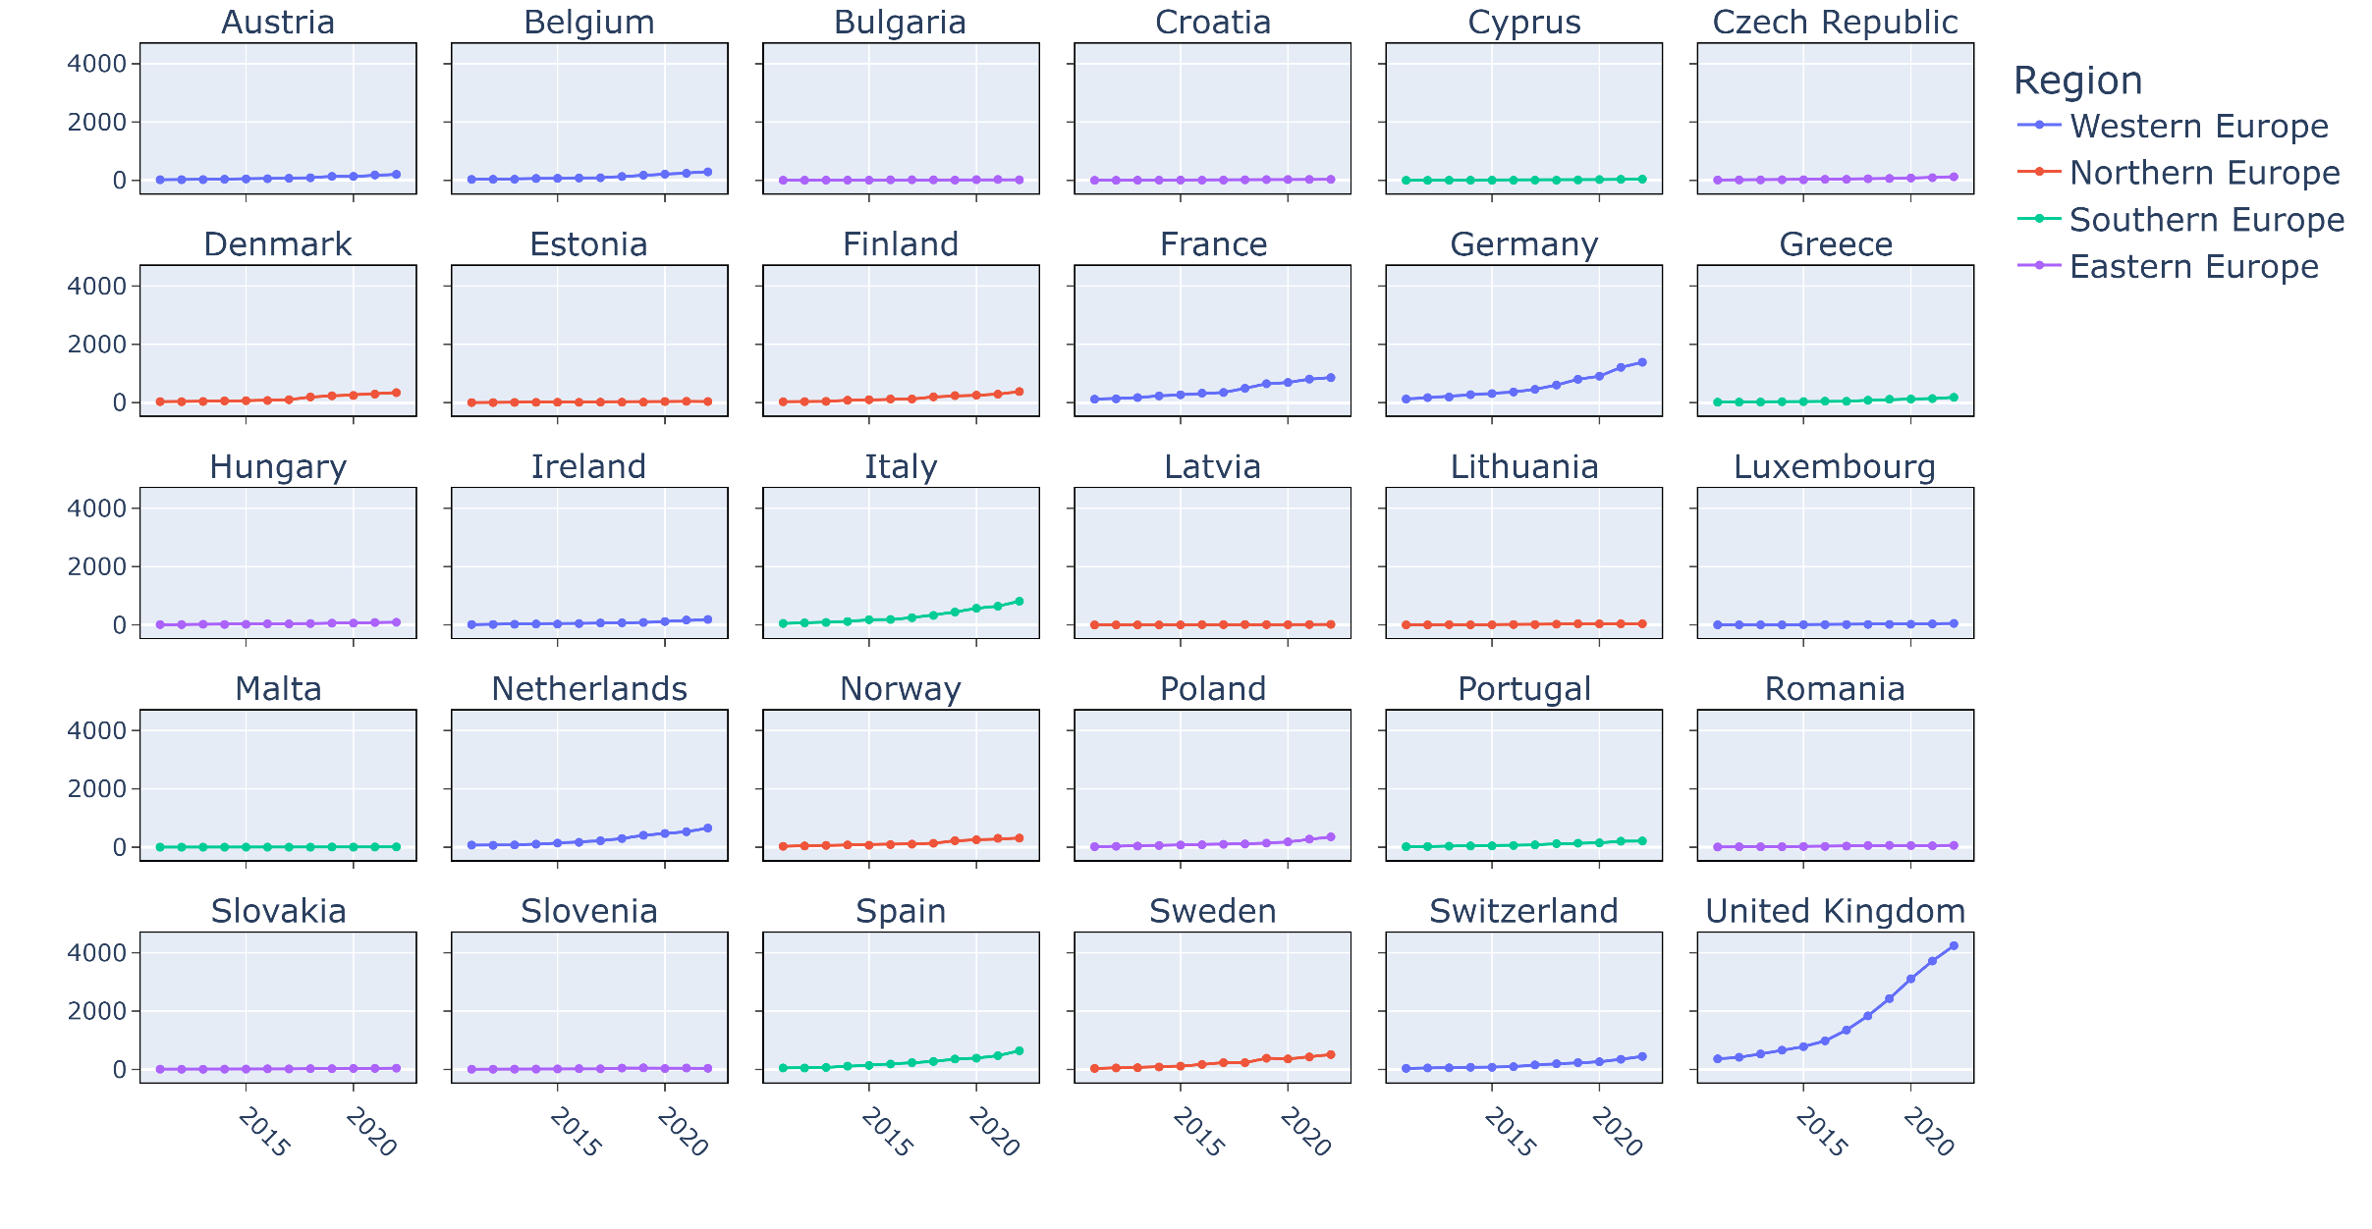
YeARLY OUTPUT of CO-PUBLICATIONS

Slide 13
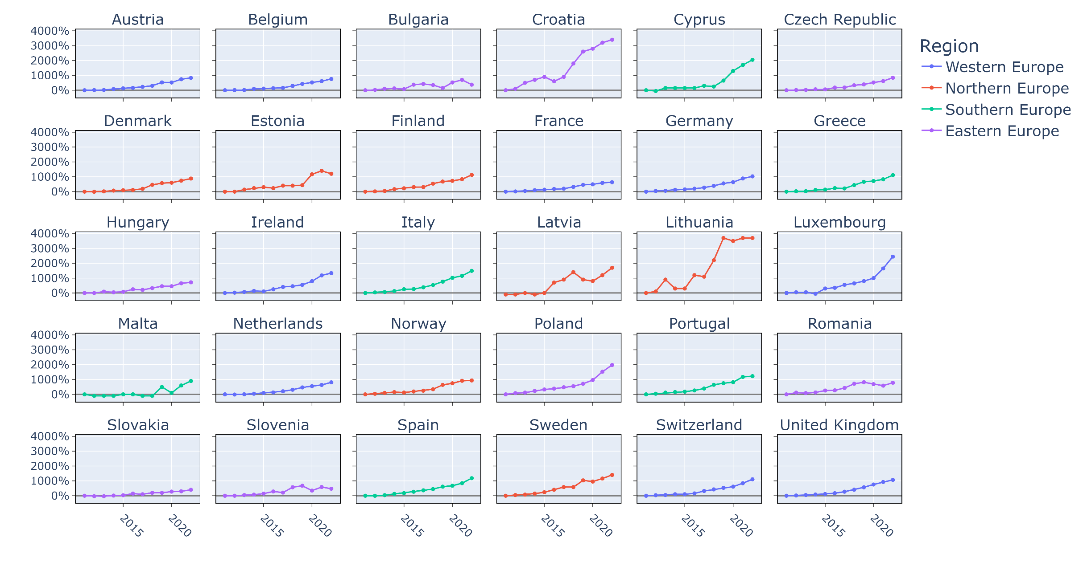
RELATIVE INCREASE IN YEARLY CO-publication OUTPUT
At least 7-10x increase in each country
TOP:
Croatia - Lithuania
BOTTOM:
France - Slovakia
Slovenia-Bulgaria patterns?
Poland

Slide 14
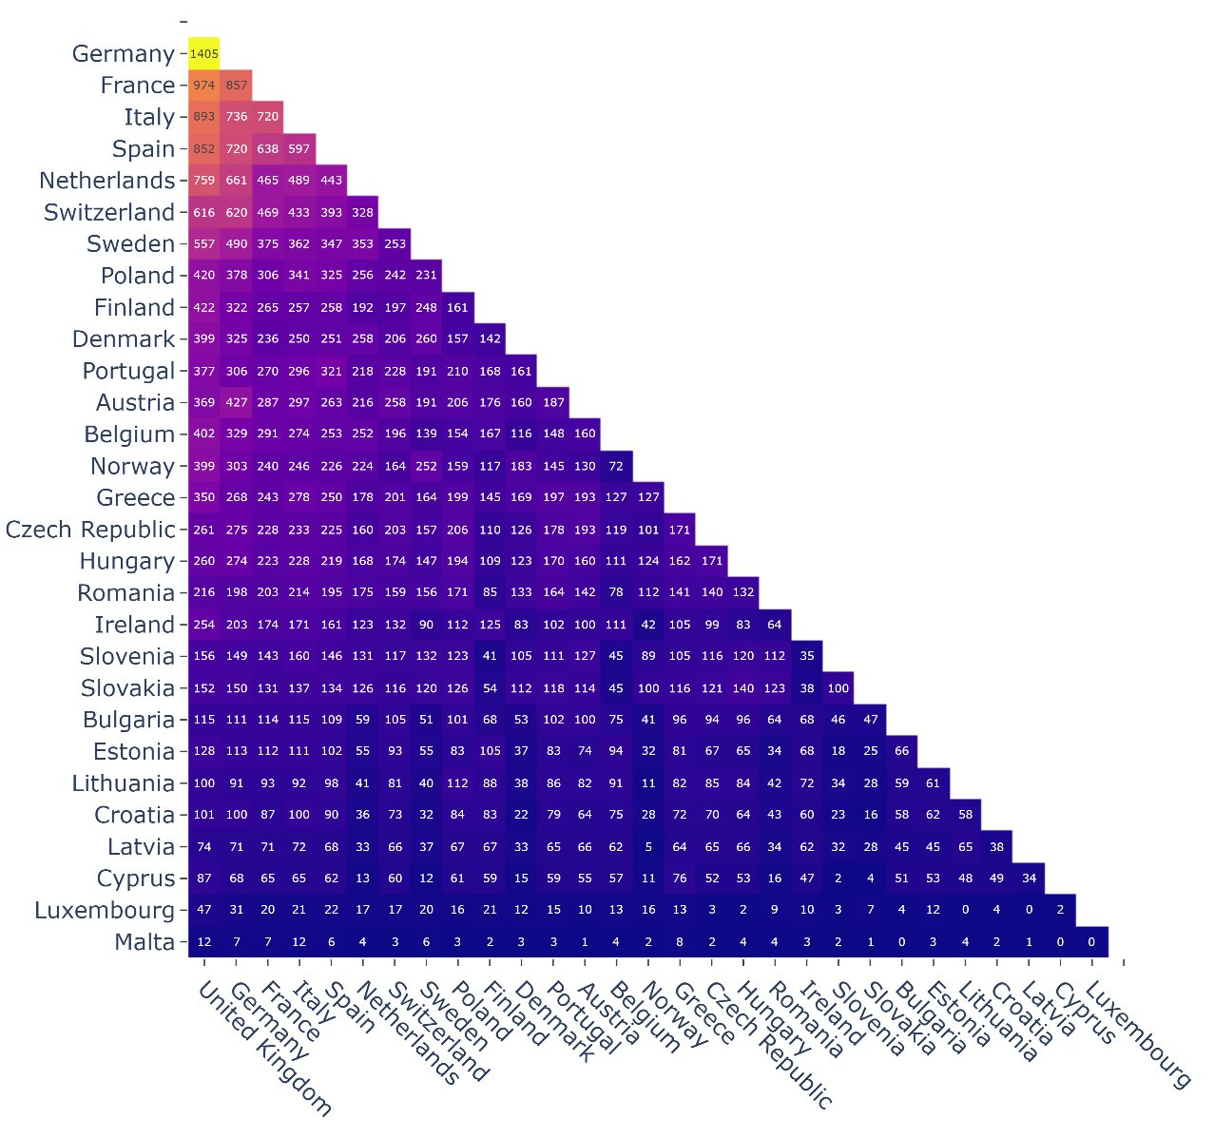
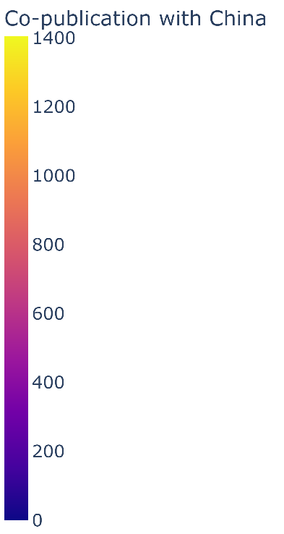
INTRA-EUROPEAN PATTERNS
Most active interactions within Europe having common co-publications with China in the field
Major collaborators on top/front
Noteworthy interactions:
  Austria – Germany
  Sweden – Norway
  Portugal - Spain

Slide 15
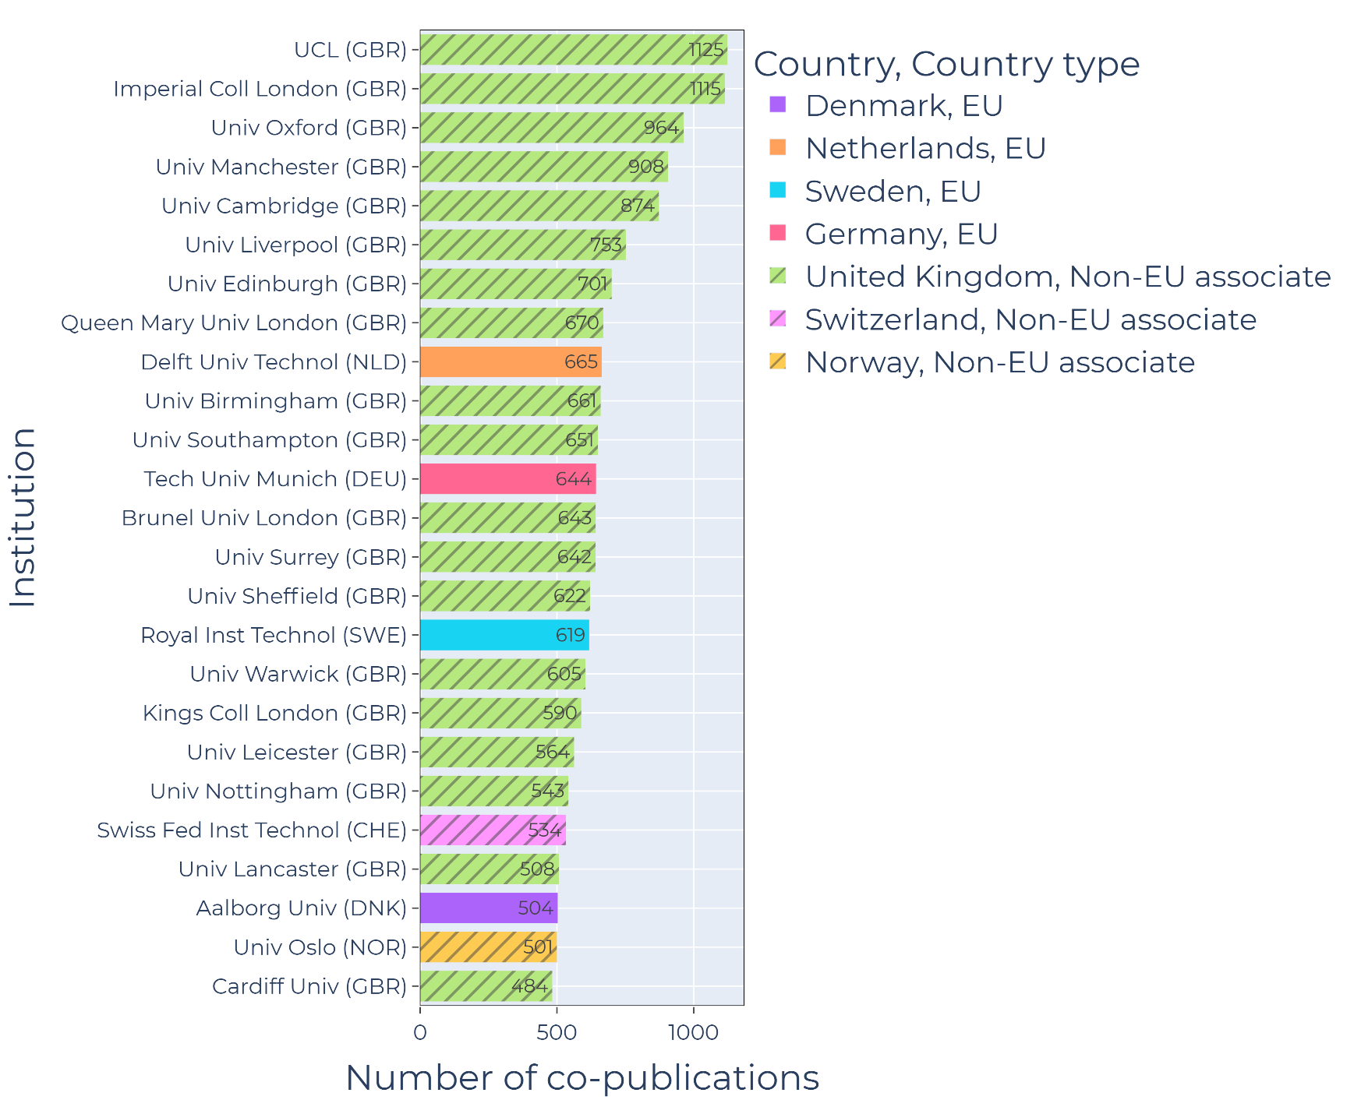
EUROPEAN INSTITUTES
Most visible contributors:
Mostly non-EU28 countries
Great Britain
Despite the not large contribution of Norway, (11th) University of Oslo maintains a prominent place

Slide 16
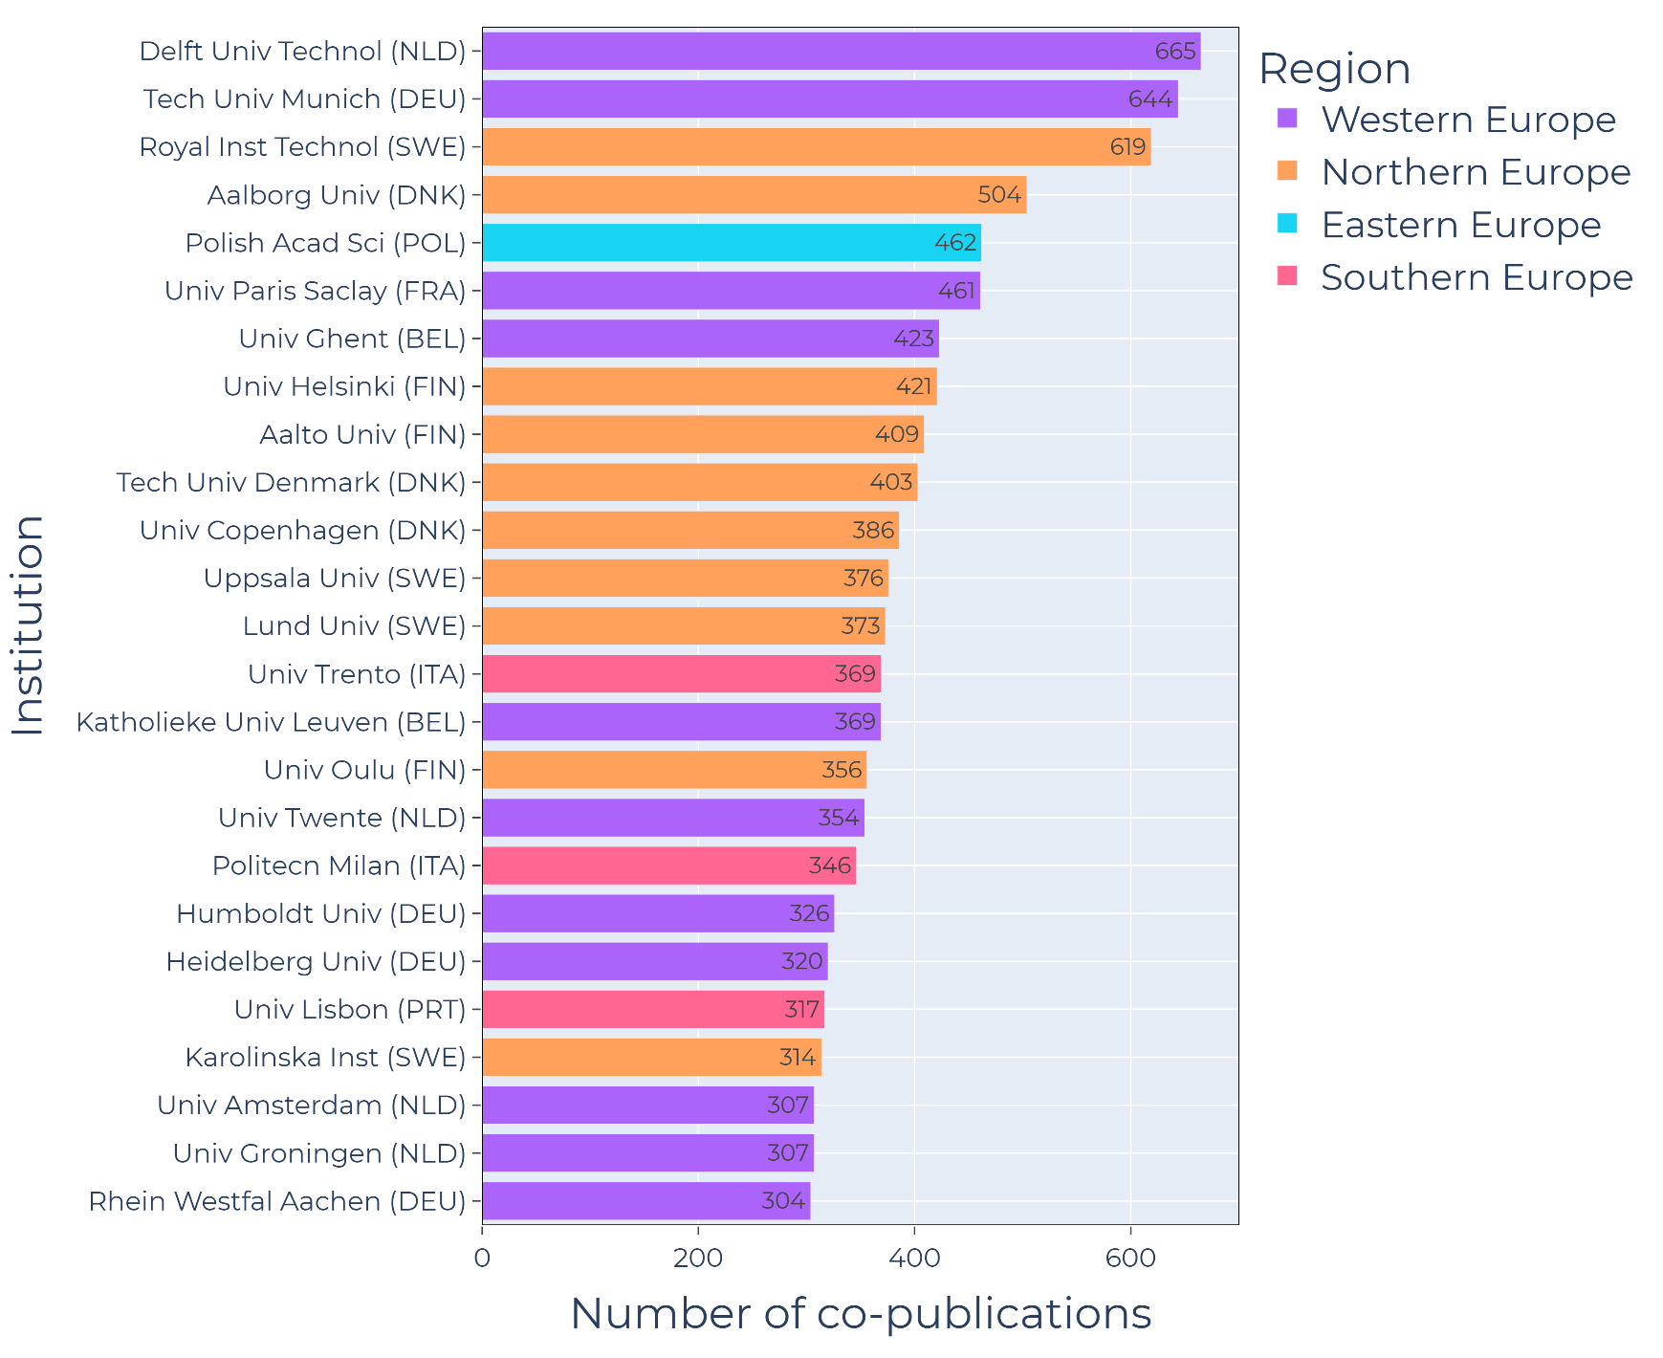
EU28 INSTITUTES
Most visible EU28 institutes
Mostly Western and Northern EU
  Netherlands
  Germany
  Denmark
  Sweden
  Finland
Polish Academy of Science in a surprising place

Slide 17
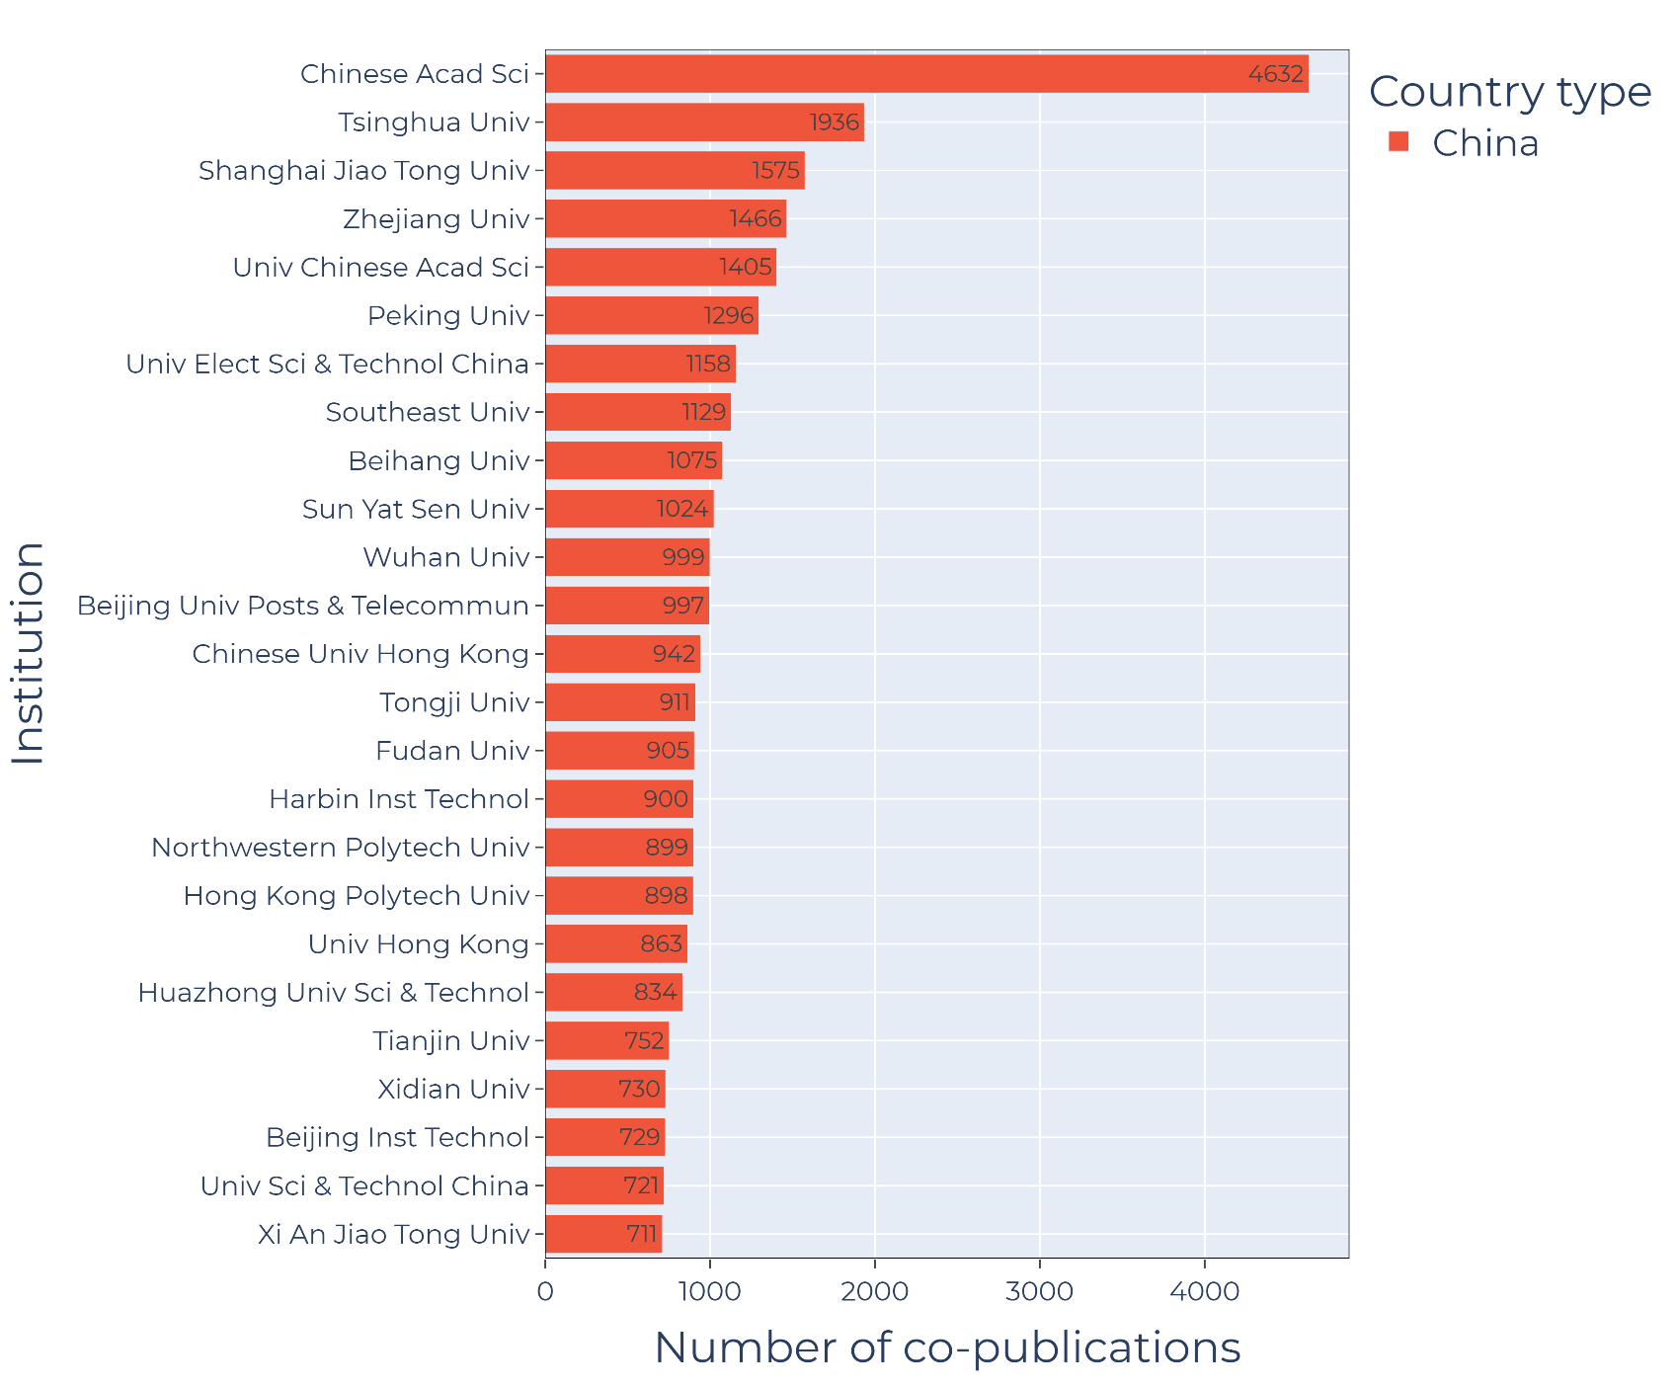
CHINESE INSTITUTES
Chinese Academy of Science: Overwhelming majority (mainly applicational domains

Slide 18
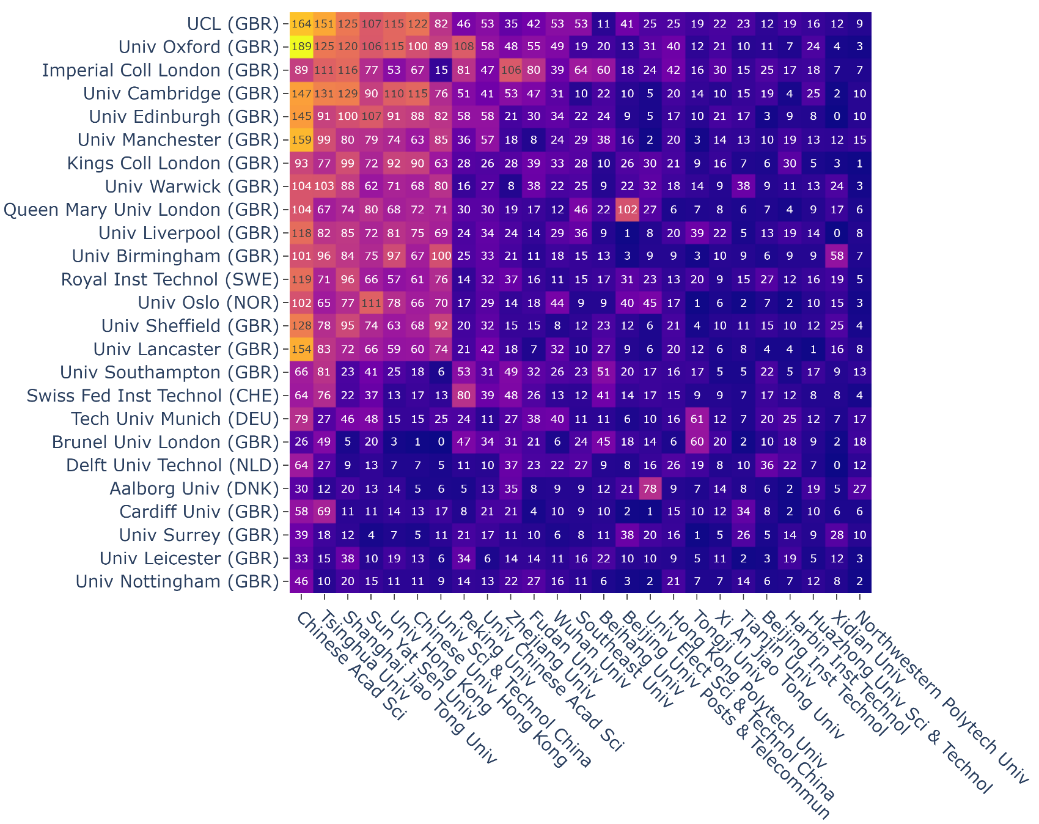
COLLABORATION PATTERNS (EUROPE-China)
Most visible collaborations are between the highest contributors of the scope
Worth to mention:
  Queen Mary University of London – Beijing University of Post & Telecommunication
  Aalborg University – University of Electronic Science & Technology China
  Technical University of Munich / Brunel University of London – Tongji University

Slide 19
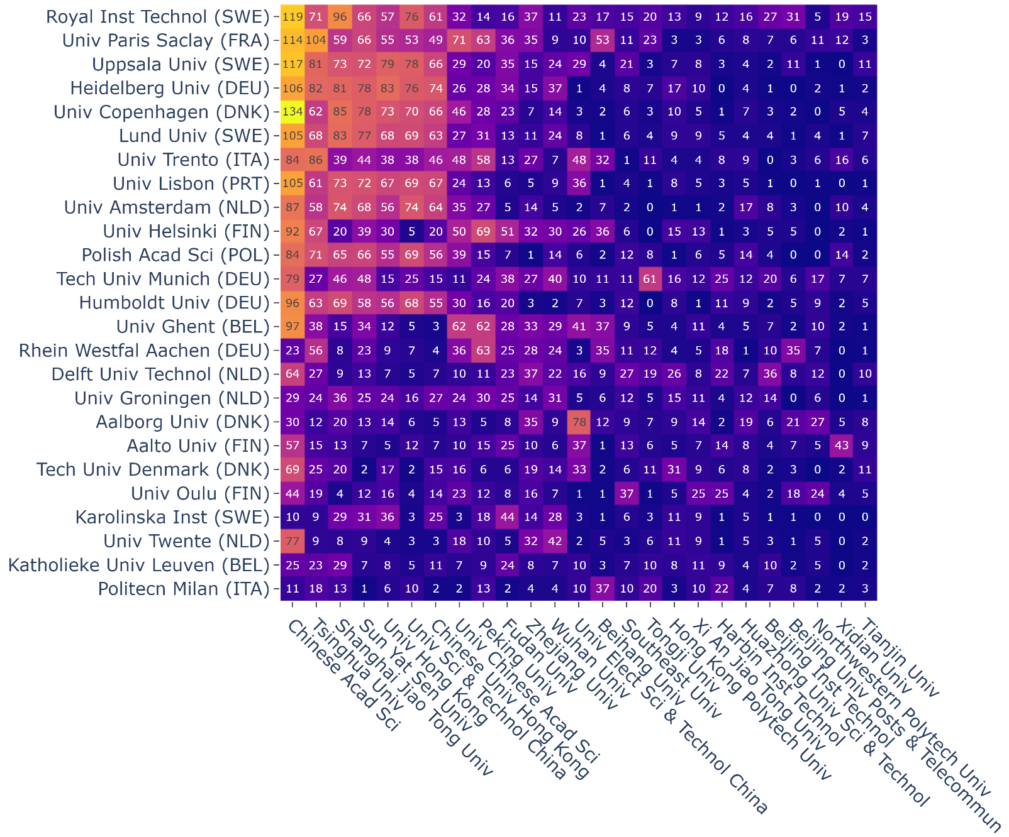
COLLABORATION PATTERNS (EU28-China)
Most visible collaborations are between the highest contributors of the scope
Worth to mention:
  Aalborg University – prominent co-publisher but not necessarily with the largest chinese partners
  Aalto University – Xidian University

Slide 20
APPLIED SCIENCES

Slide 21
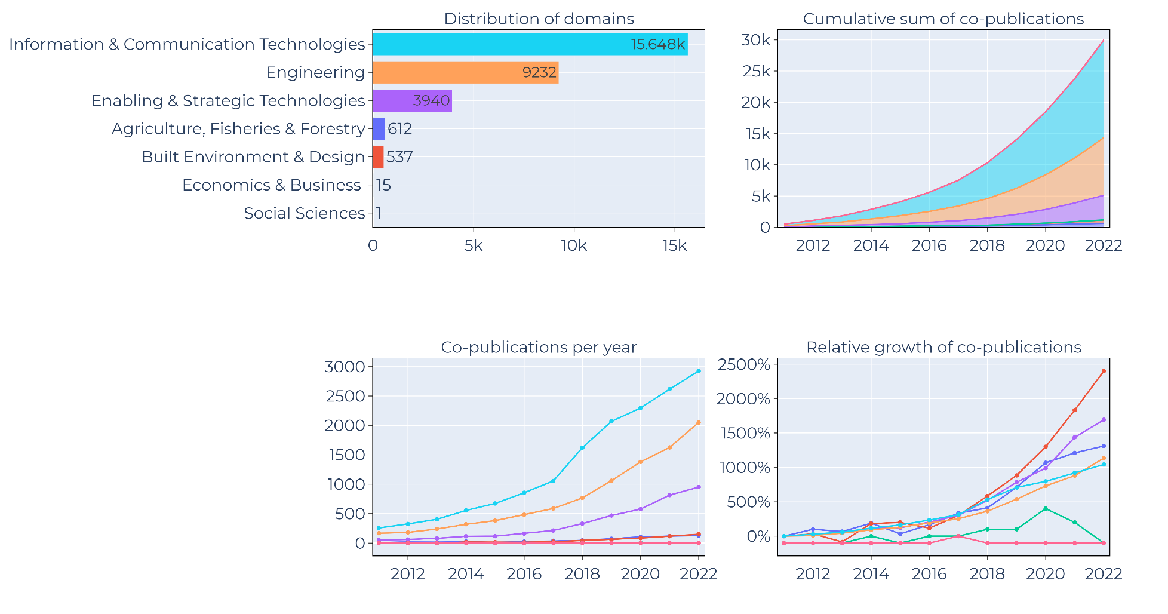
Distribution & Trends: Applied Sciences
Mostly technology oriented
Built environment & design: low but the fastest growing branch of the domain

Slide 22
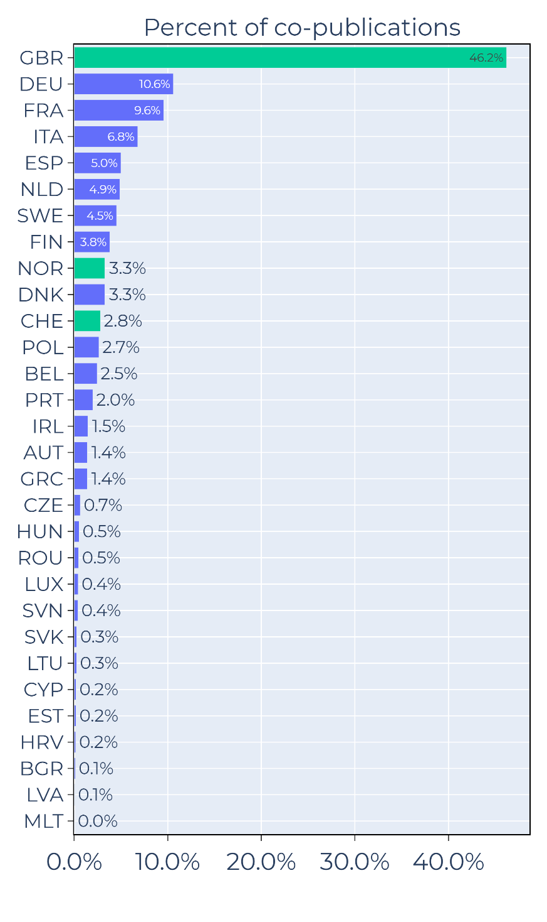
Distribution & Trends: Scientific Domains
Resembling the overall contributional patterns (since Applied Science was the most prominent domain of our scope ~65%)
Majority of co-publications related to Britain, Western Europe & Nordic region

Slide 23
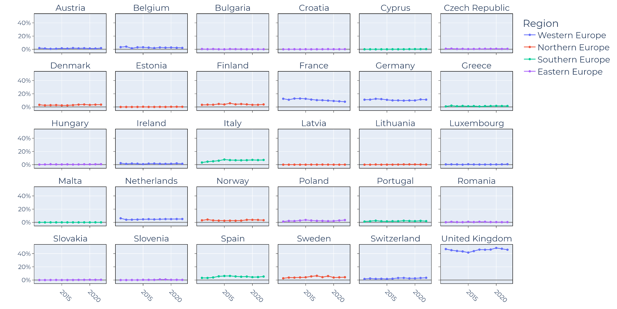
Yearly TRENDS in CO-publication FOCUS OF CHINA
Similar as before, mostly constant patterns
France: slight decline
UK: small fluctuations
Few 2015-2018 plateous

Slide 24
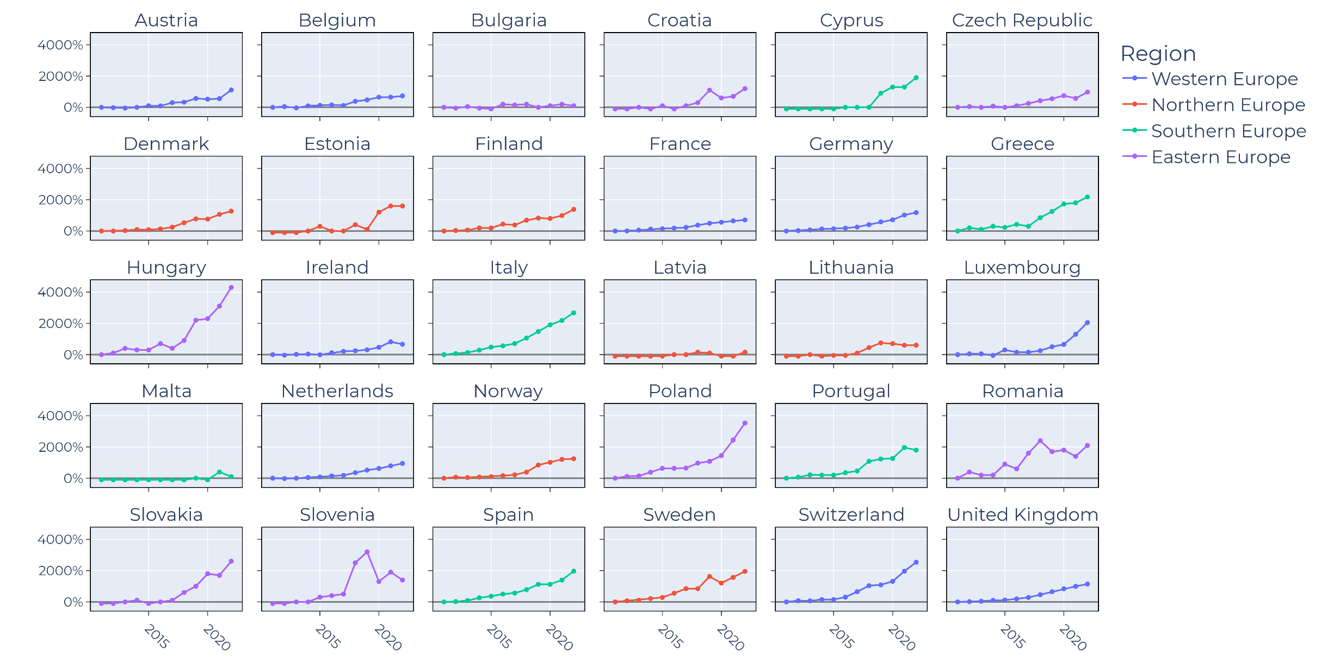
RELATIVE INCREASE IN YEARLY CO-publication OUTPUT
~2017-18 boom in some countries
TOP:
Hungary - Poland
BOTTOM:
France - Slovakia
Slovenia-Romania patterns

Slide 25
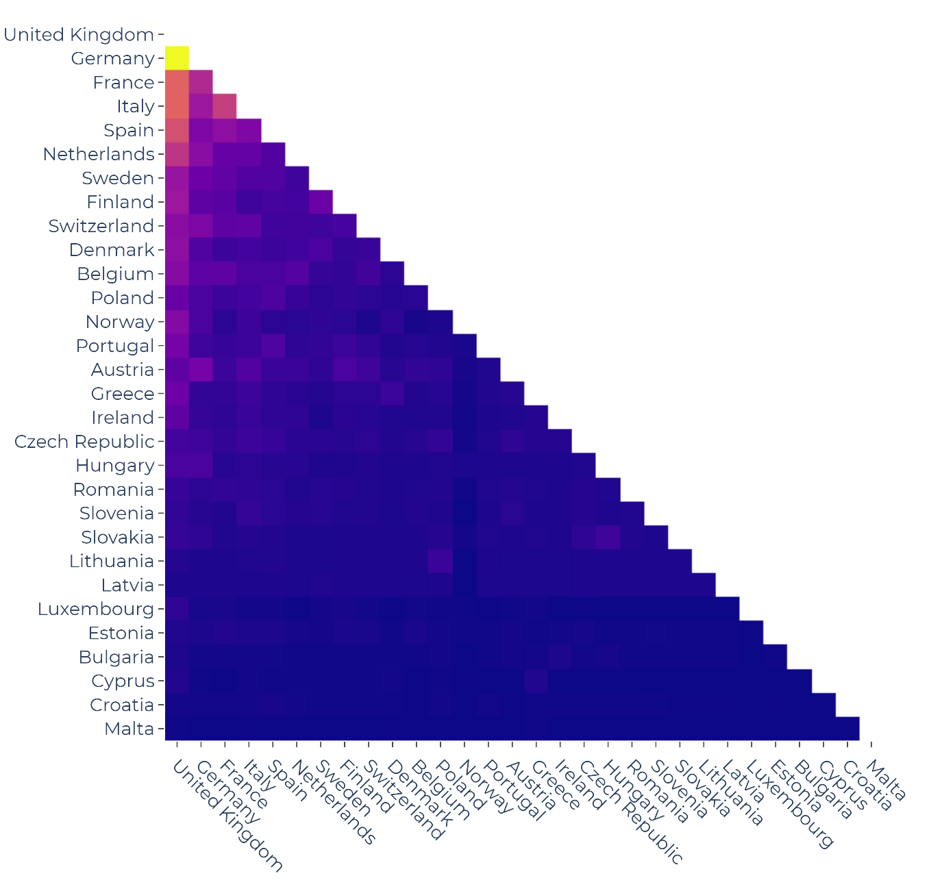
INTRA-EUROPEAN PATTERNS
Most active interactions within Europe having common co-publications with China in the field
Major collaborators on top/front
Noteworthy interactions:
  Lithuania – Poland
  Slovakia – Hungary

Slide 26
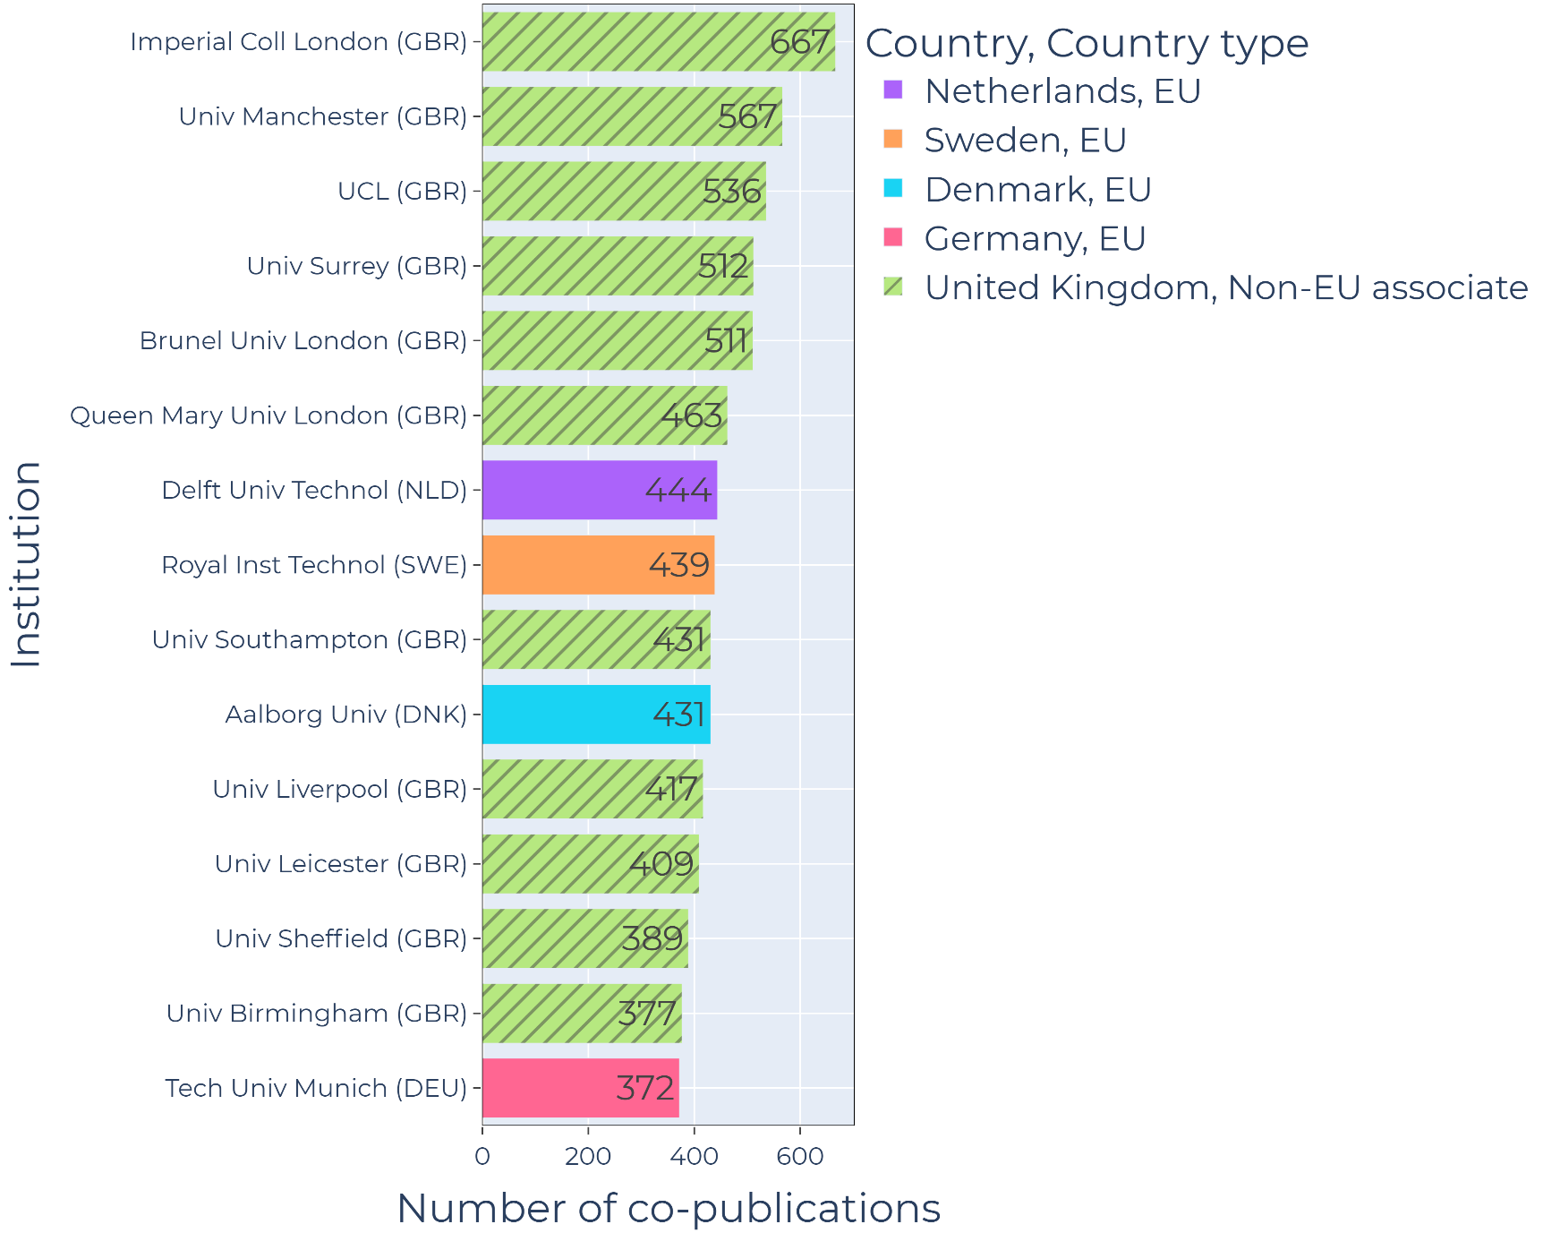
EUROPEAN INSTITUTES
Most visible contributors:
Mostly non-EU28 countries
Great Britain

Slide 27
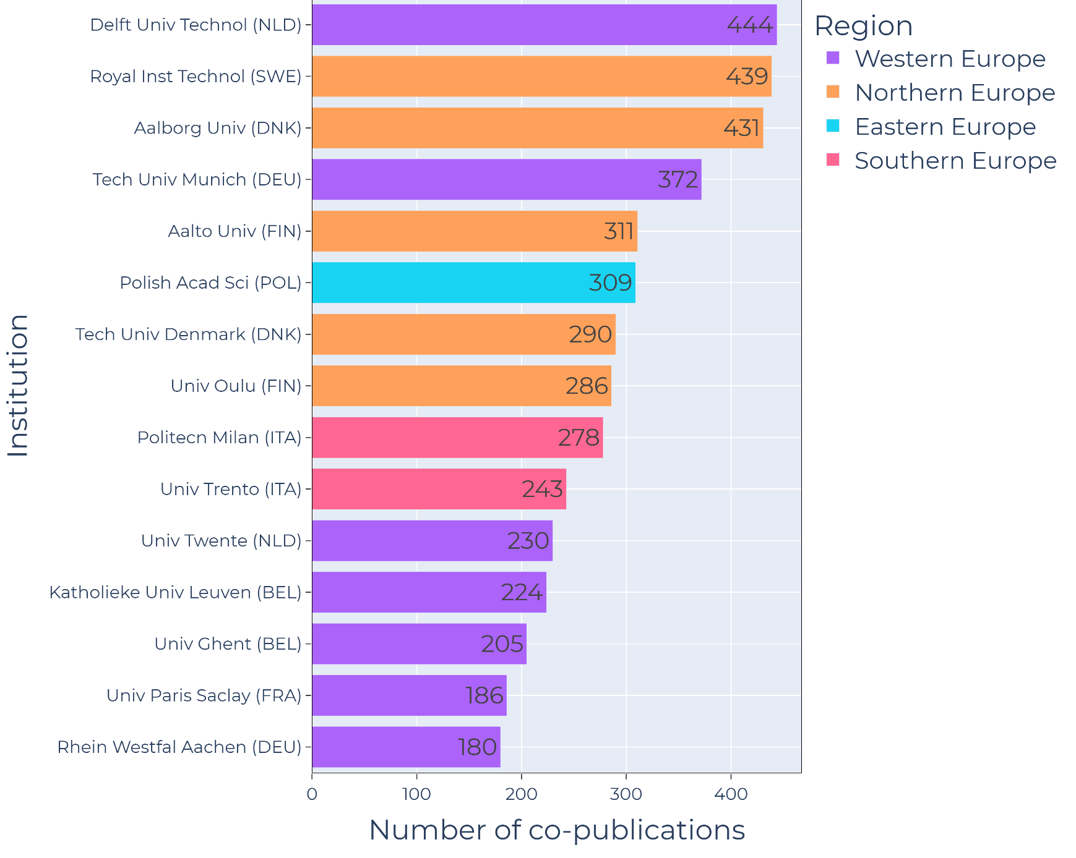
EU28 INSTITUTES
Most visible EU28 institutes
Mostly Western and Northern EU
Polish Academy of Science in a surprising place

Slide 28
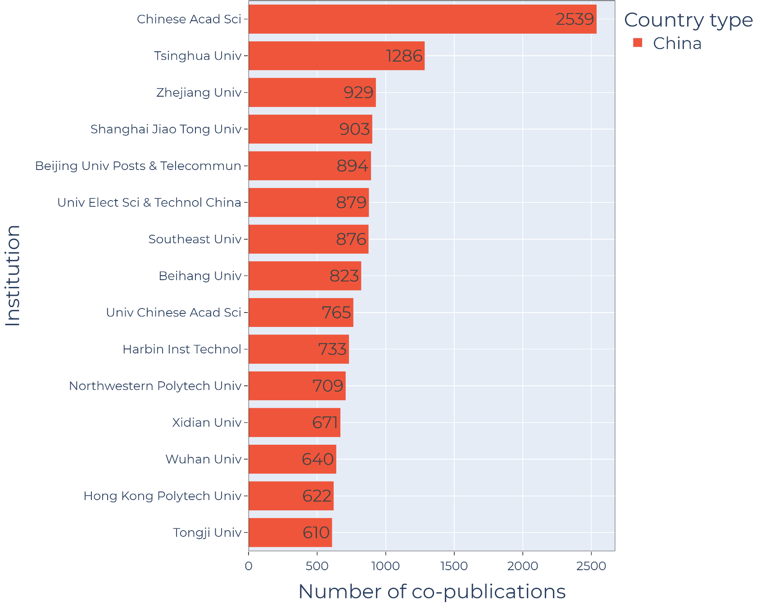
CHINESE INSTITUTES
Similar as before
Chinese Academy of Science: Overwhelming majority (mainly applicational domains

Slide 29
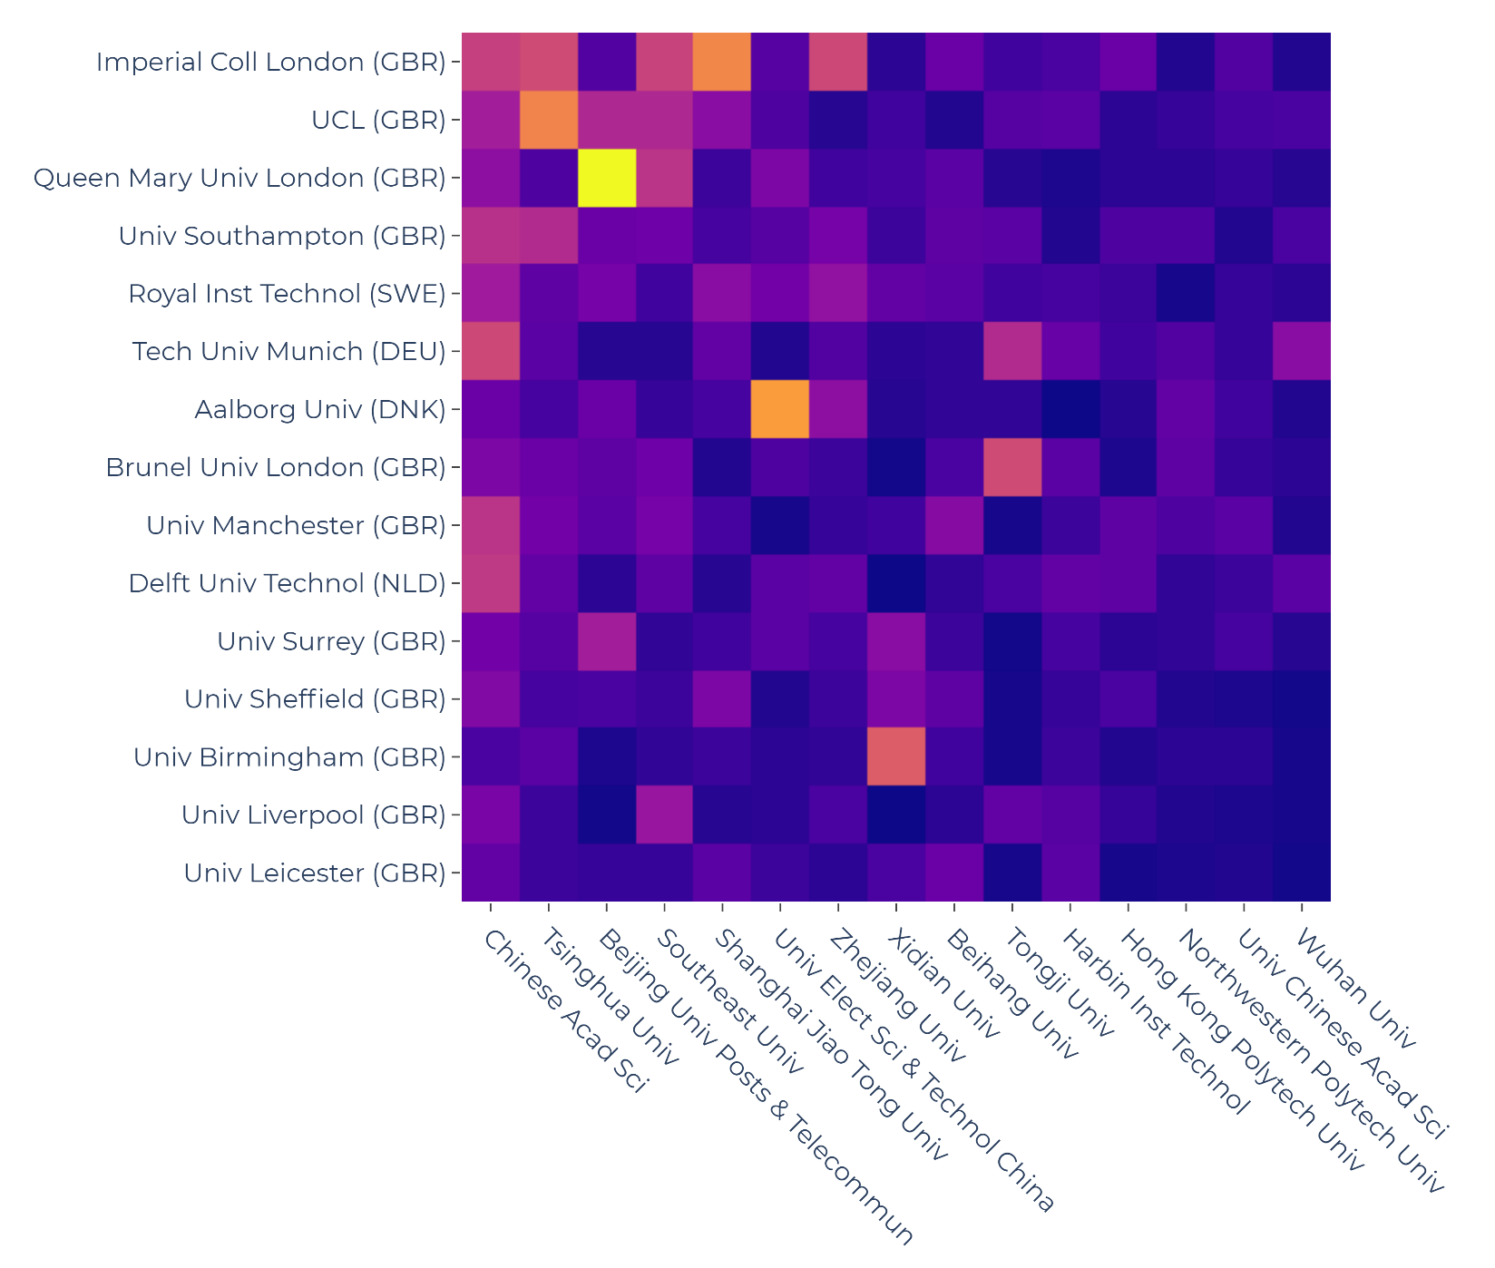
COLLABORATION PATTERNS (EUROPE-China)
Most visible collaborations are between the highest contributors of the scope
Worth to mention:
  Queen Mary University of London – Beijing University of Post & Telecommunication
  Aalborg University – University of Electronic Science & Technology China
  University of Birmingham – Xidian University
  Brunel University of London – Tongji University

Slide 30
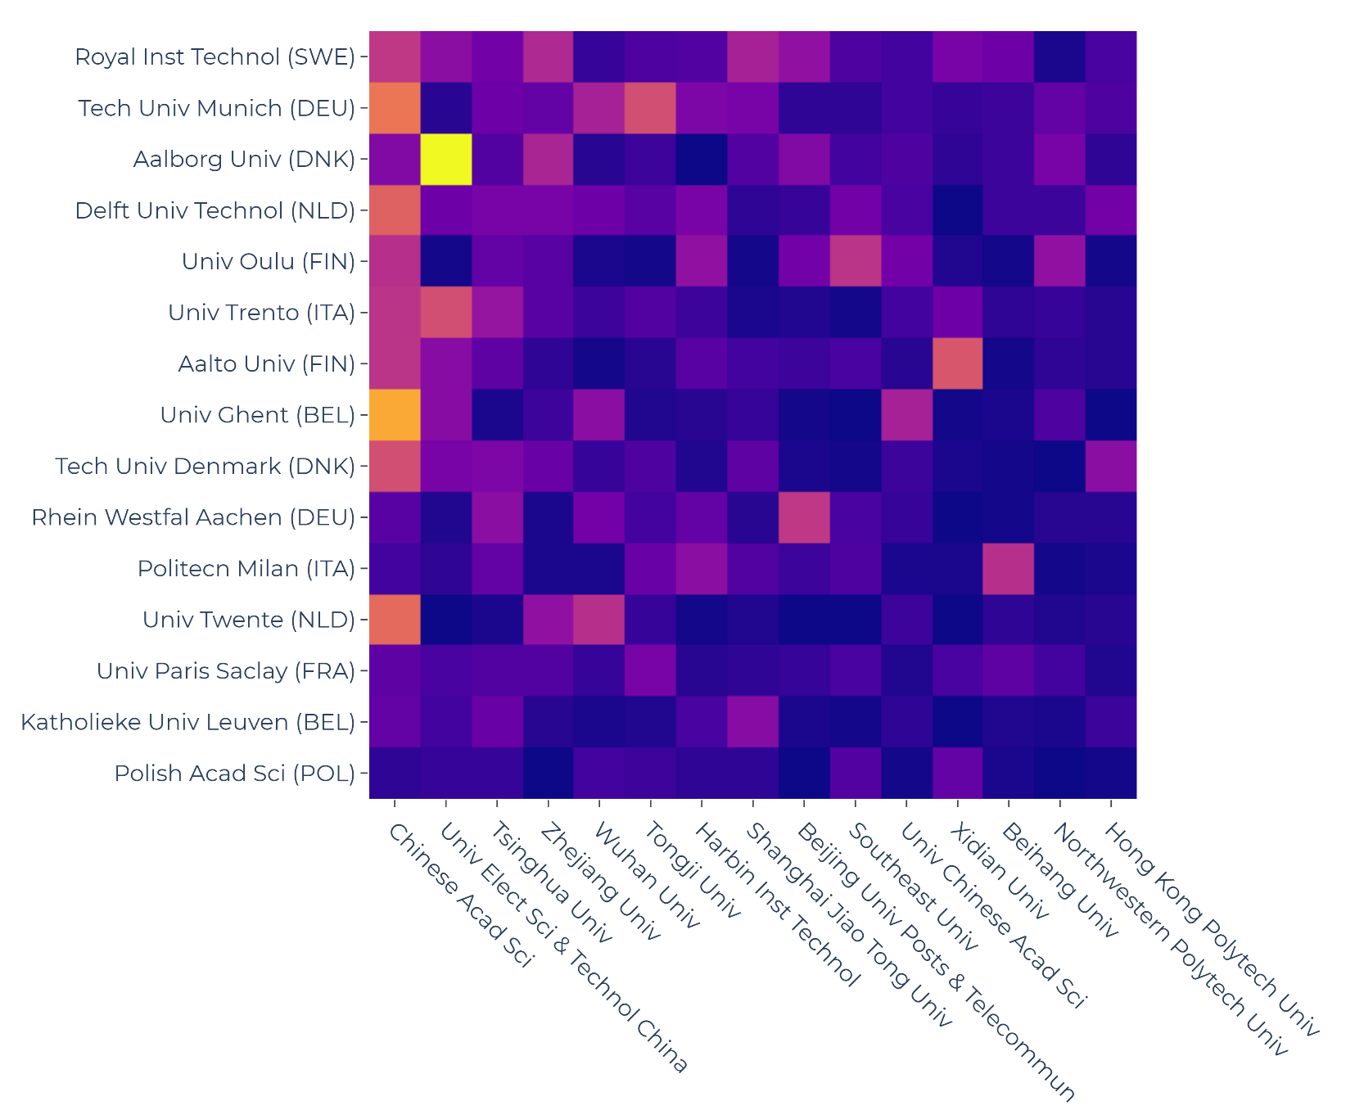
COLLABORATION PATTERNS (EU28-China)
Most visible collaborations are between the highest contributors of the scope
Worth to mention:
  Aalto University – Xidian University
  RWTH Aachen – Beijing University of Posts and Telecommunications
  Politecnico Milano – Beihang University

Slide 31
NATURAL SCIENCES

Slide 32
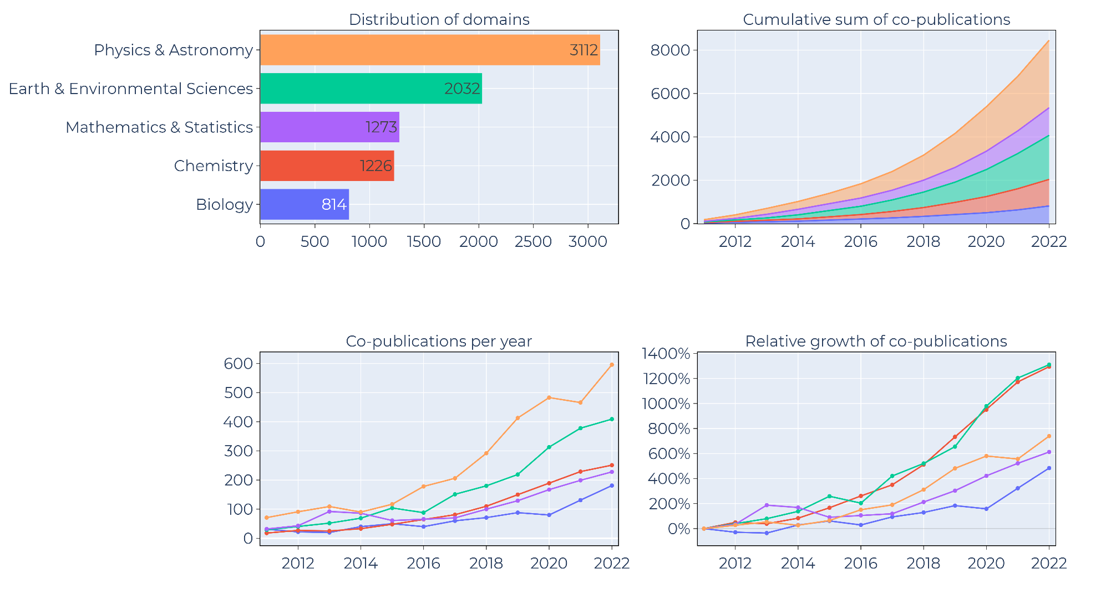
Distribution & Trends: NATURAL Sciences
Relatively evenly distributed
Chemistry & environmental science are the fastest growing fields

Slide 33
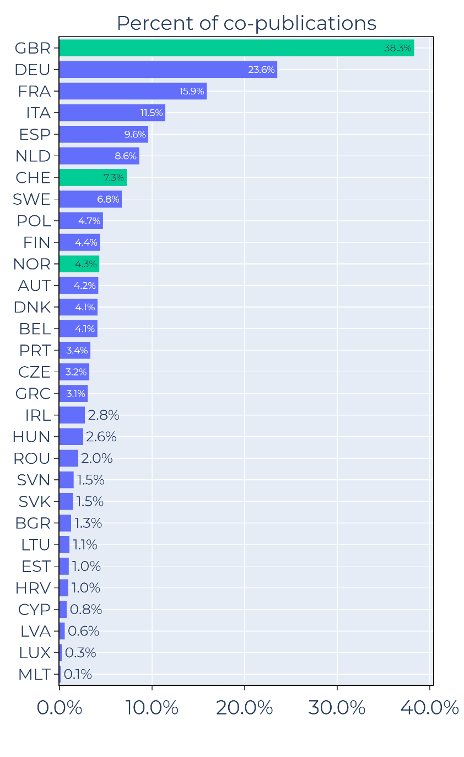
Distribution & Trends: Scientific Domains
More evenly distributed than Applied Sciences
Majority of co-publications related to Britain, Western Europe & Nordic region

Slide 34
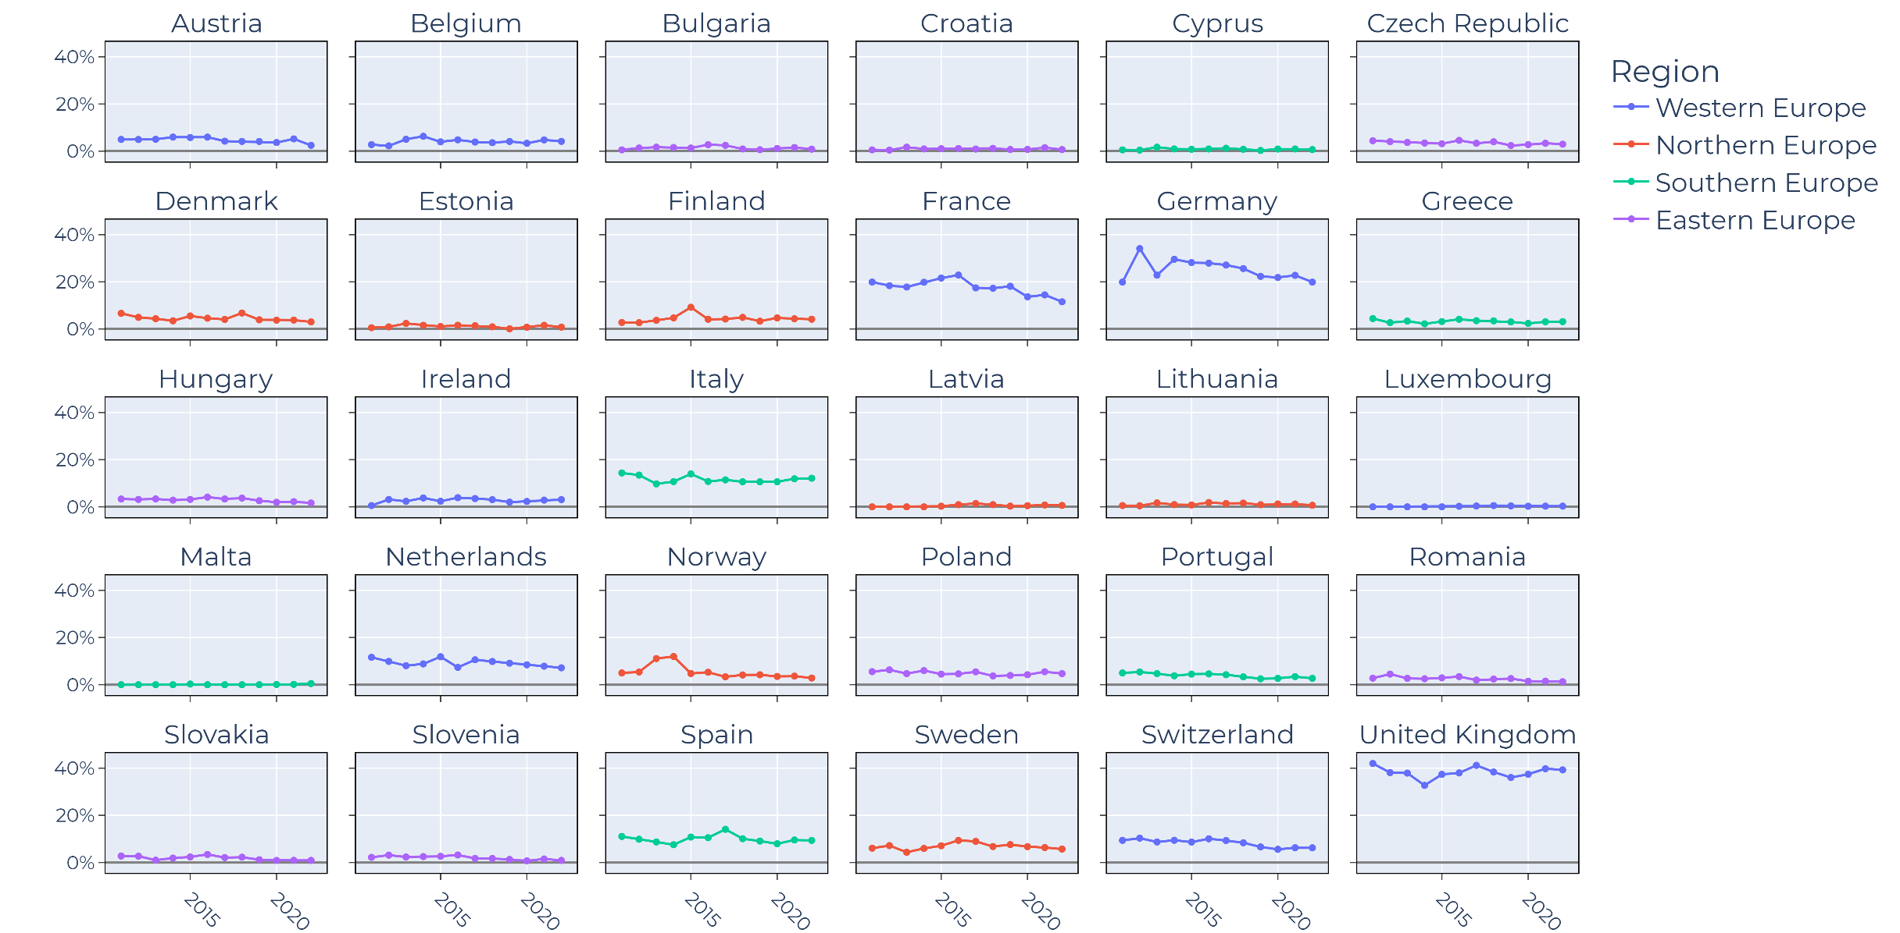
Yearly TRENDS in CO-publication FOCUS OF CHINA
France & Germany slight decline
Also in Netherland and Switzerland to some degree

Slide 35
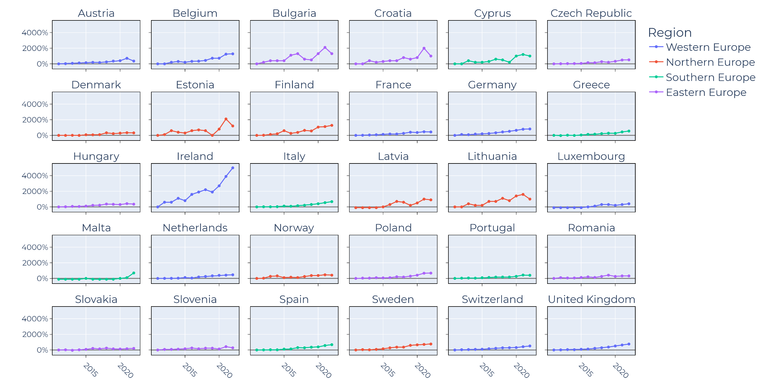
RELATIVE INCREASE IN YEARLY CO-publication OUTPUT
Uncertain growth and loss of momentum in some countries
Booming co-publication in Ireland

Slide 36
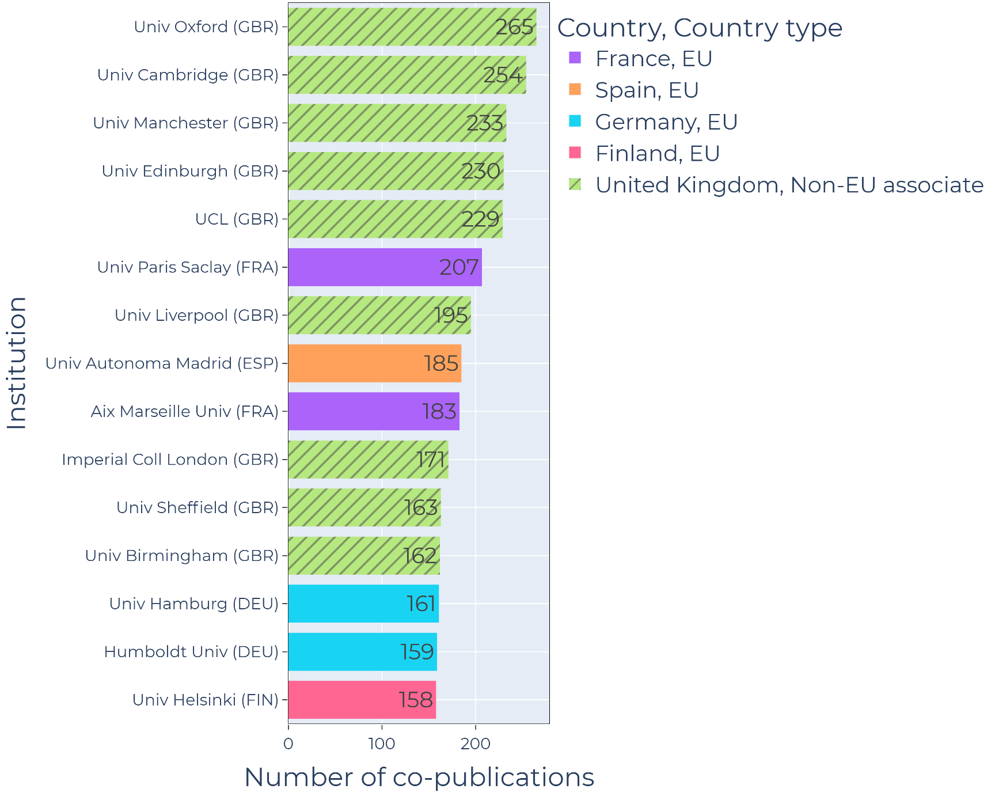
EUROPEAN INSTITUTES
Most visible contributors:
Higher representation of EU28 institutes
Still Great Britain

Slide 37
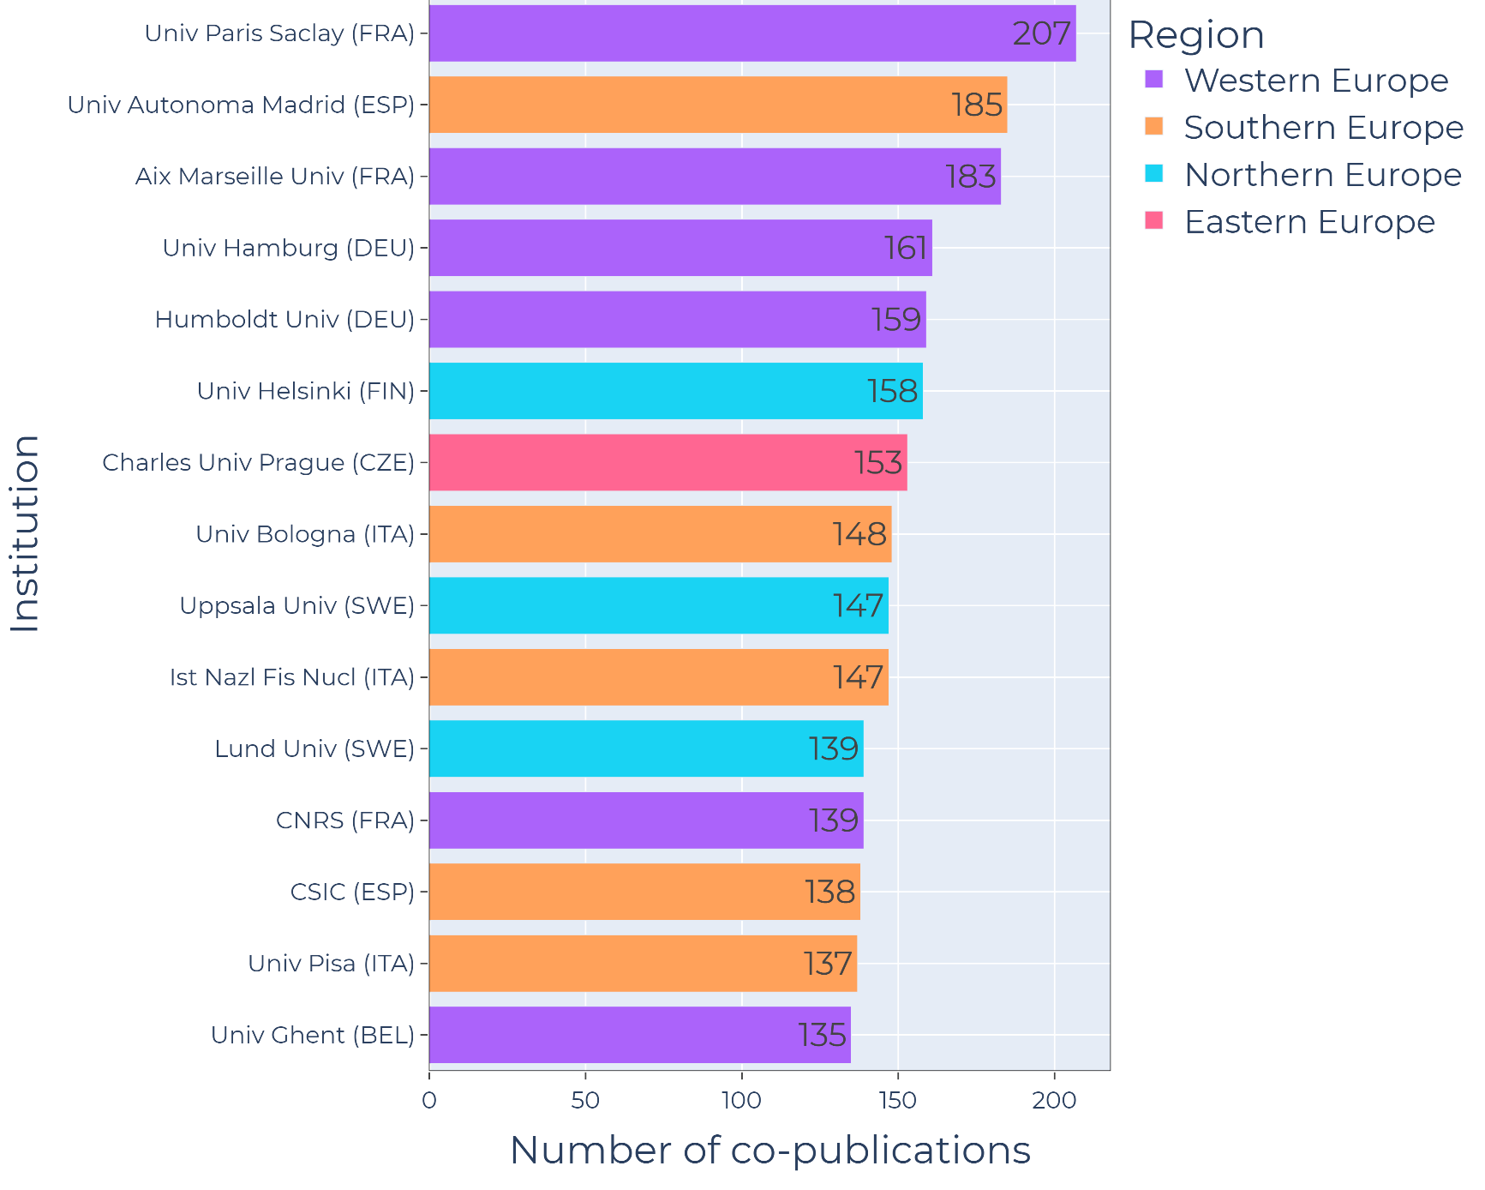
EU28 INSTITUTES
Most visible EU28 institutes
Relatively even distribution
Mostly Western and Northern EU
Charles University of Prague

Slide 38
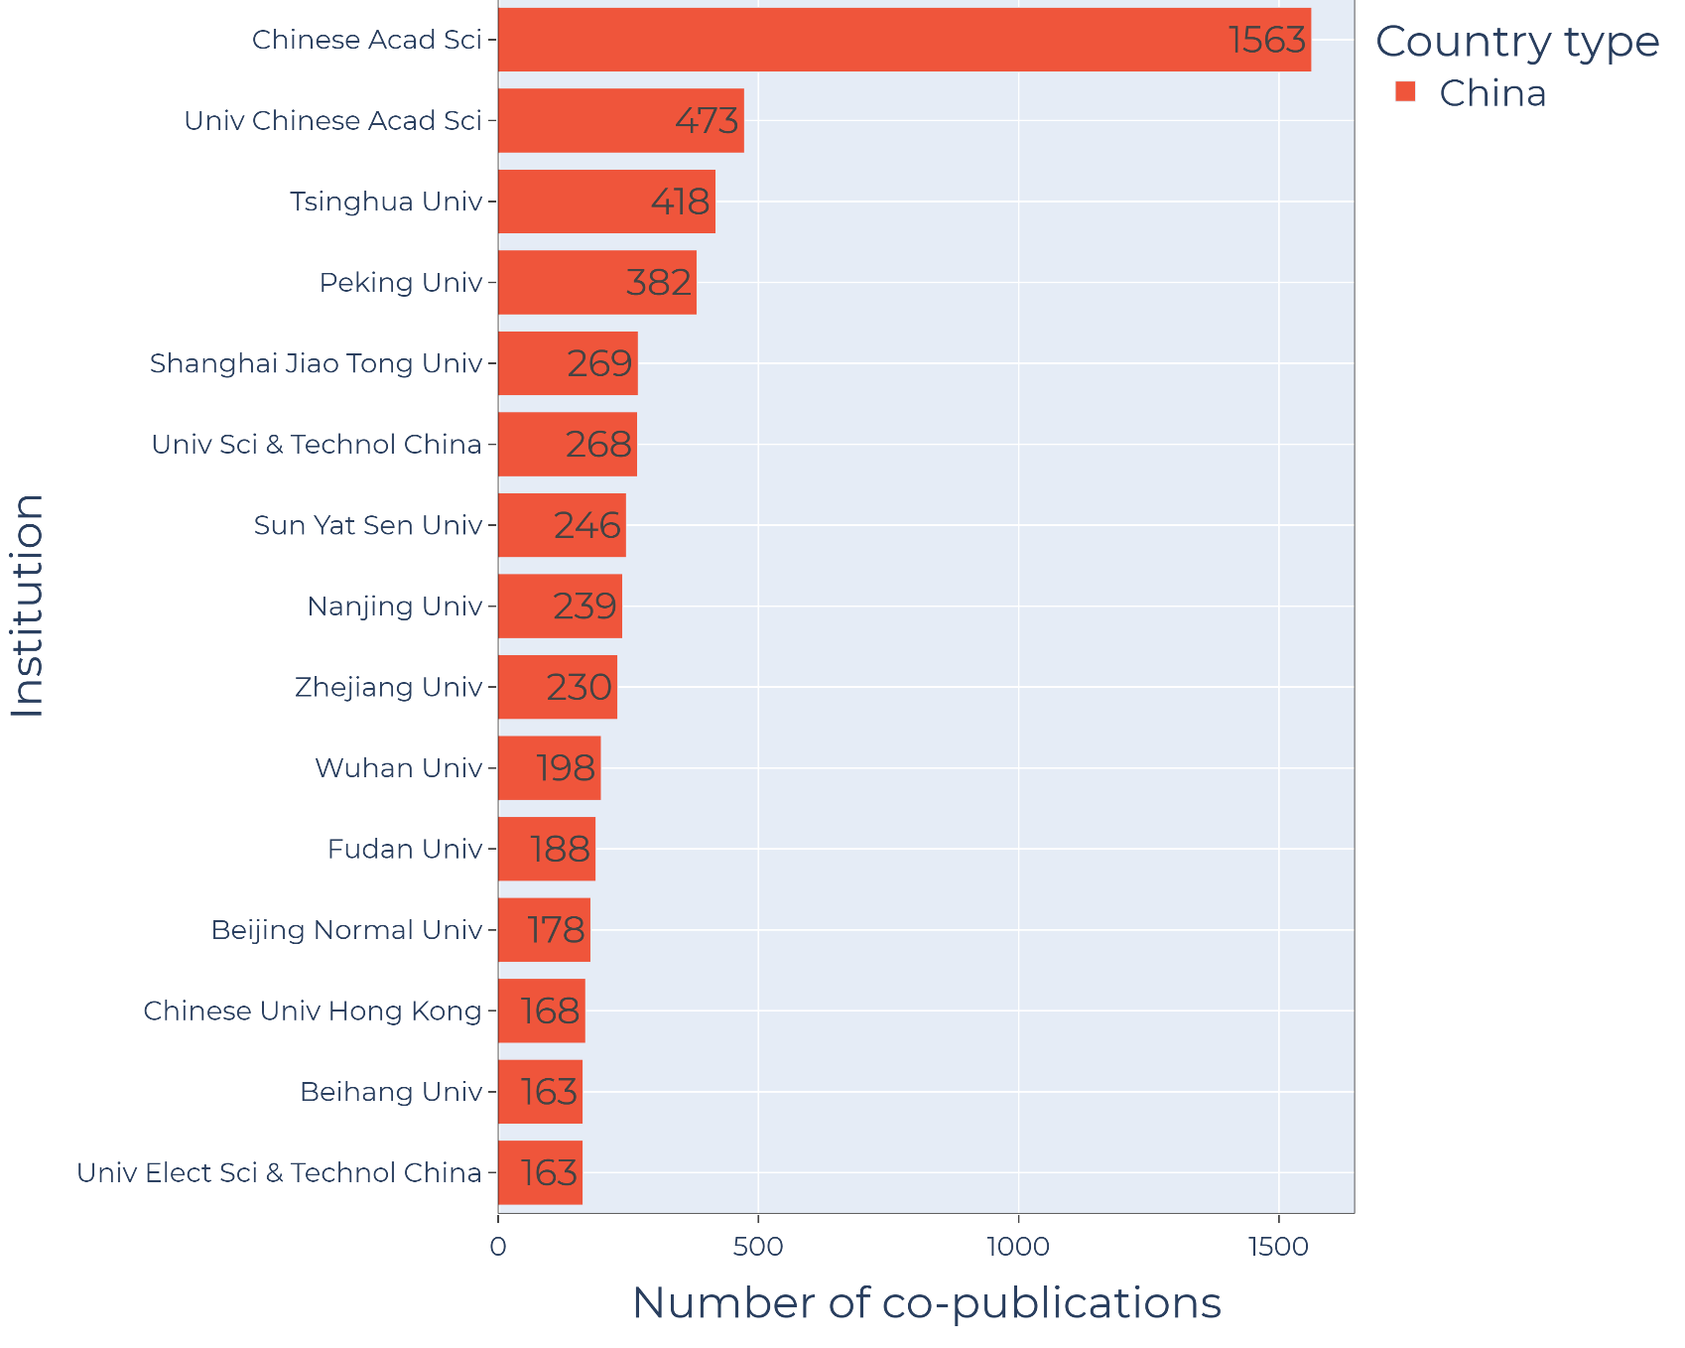
CHINESE INSTITUTES
Similar as before
Chinese Academy of Science: Overwhelming majority (mainly applicational domains
Also: University of Chinese Academy of Science at a more prominent position

Slide 39
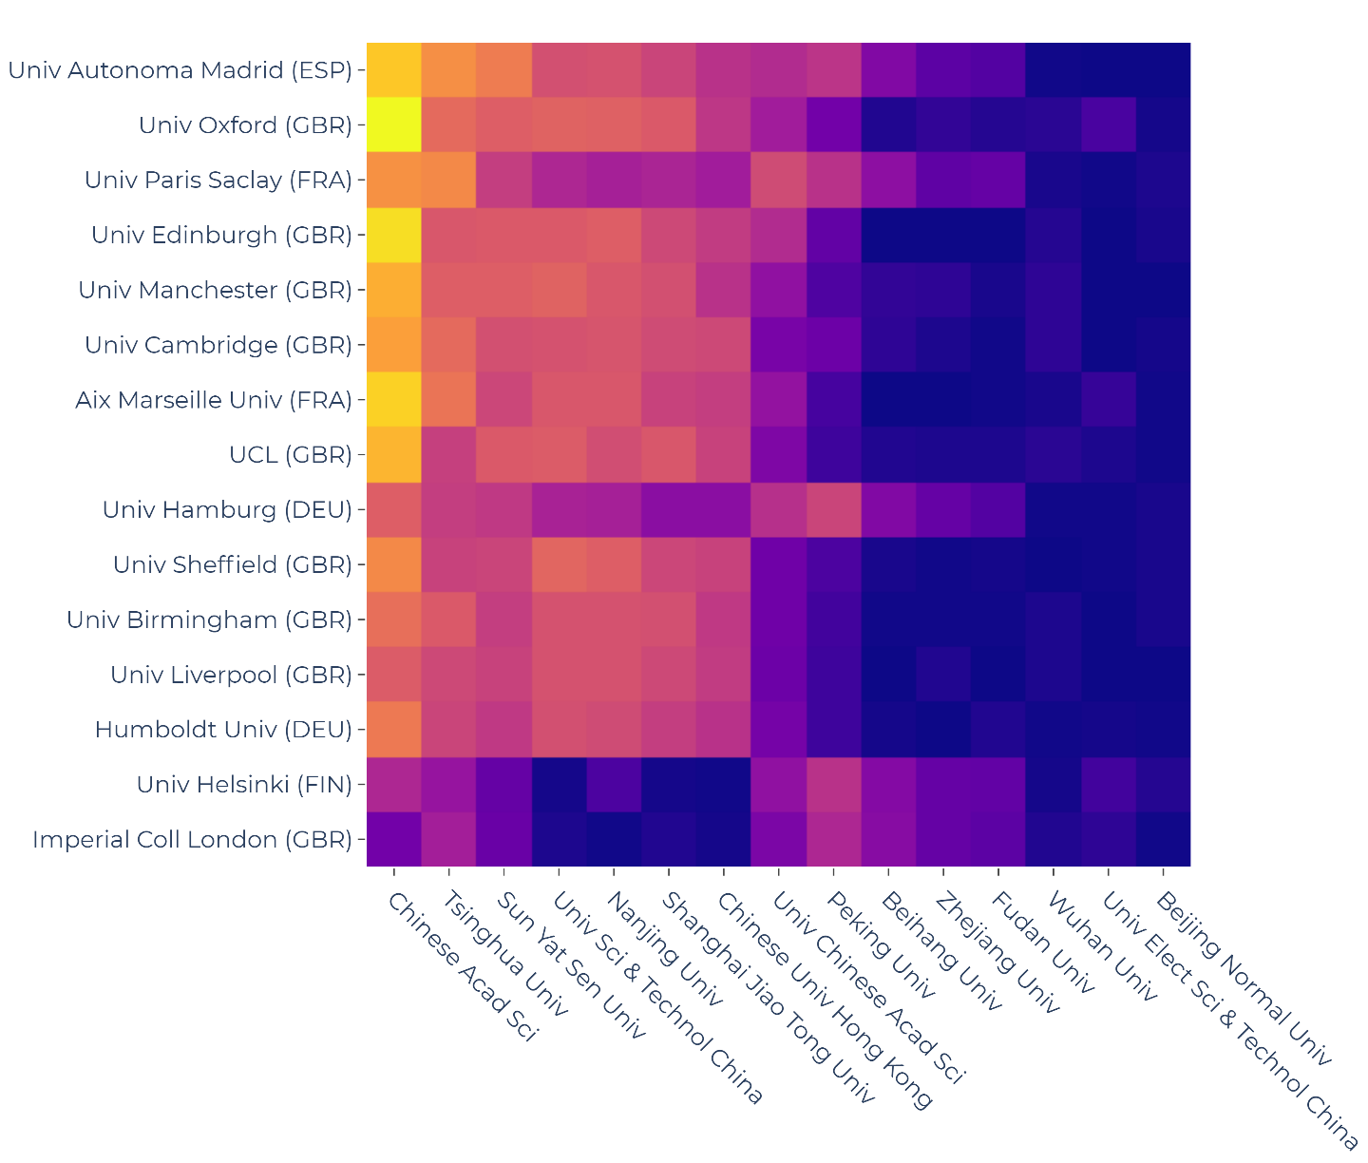
COLLABORATION PATTERNS (EUROPE-China)
Most visible collaborations are between the highest contributors of the scope

Slide 40
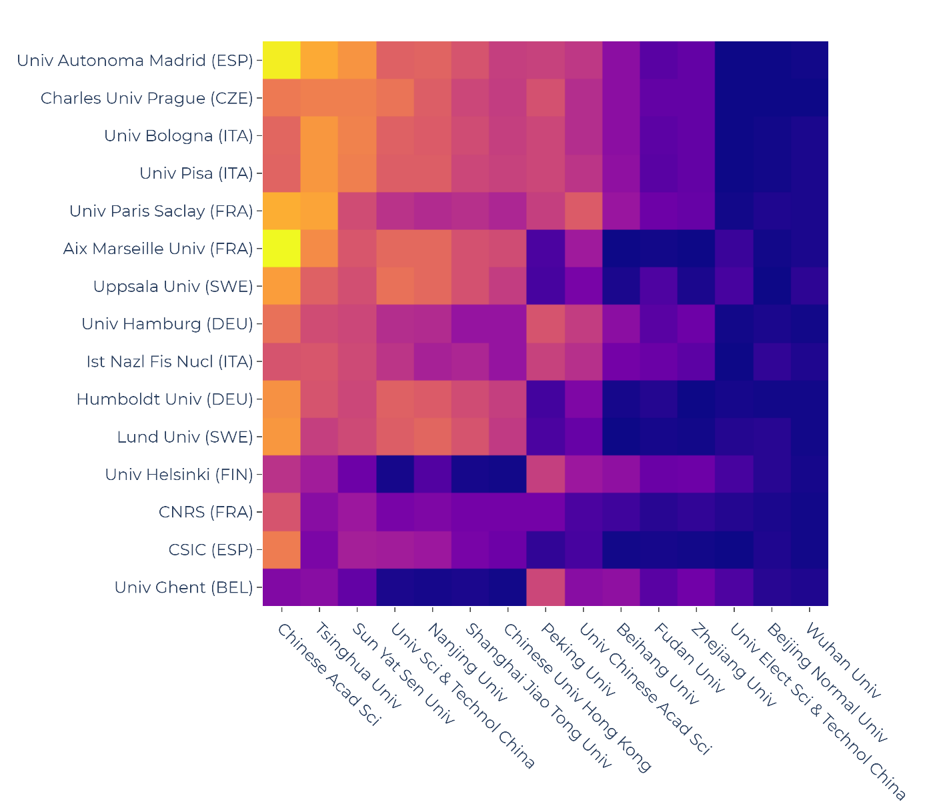
COLLABORATION PATTERNS (EU28-China)
Most visible collaborations are between the highest contributors of the scope

Slide 41
HEALTH SCIENCES

Slide 42
Distribution & Trends: Scientific Domains
Domination of applicational aspects
Recent relative increase of collaboration within economic domains
Remarks on multidisciplinary domain

Slide 43

ThAnk You
valaki@example.com

Slide 44

TemPLATE
Bullet point 1
Bullet point 2

Slide 45
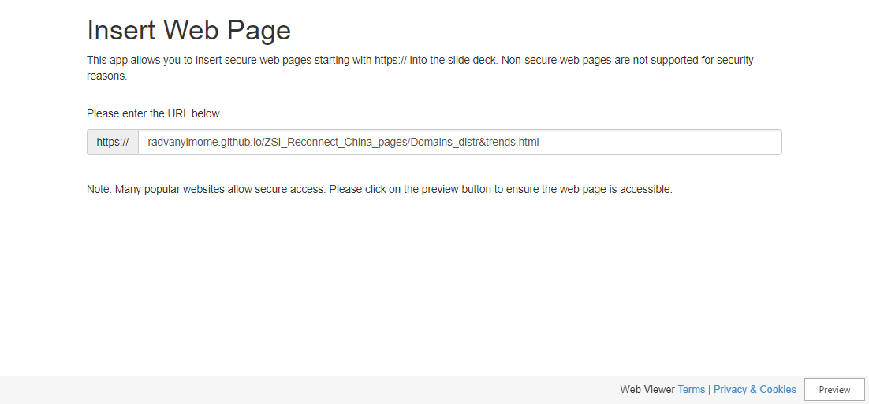
Slide 2

Slide 46
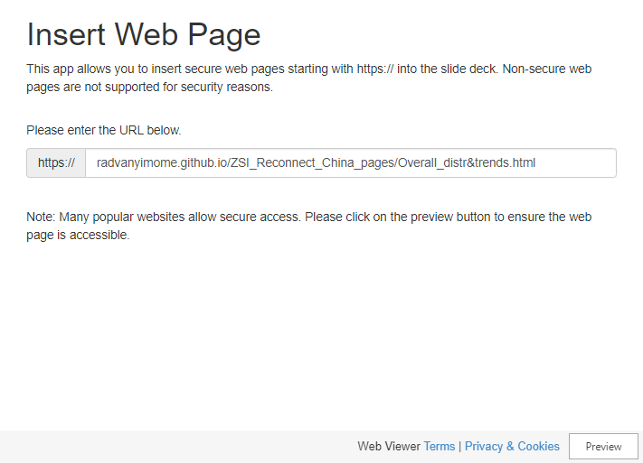
Overall Distribution & Trends
Bullet point 1
Bullet point 2
Bullet point 3

Slide 47
Overall Distribution & Trends
Bullet point 1
Bullet point 2
Bullet point 3

